Slide 1
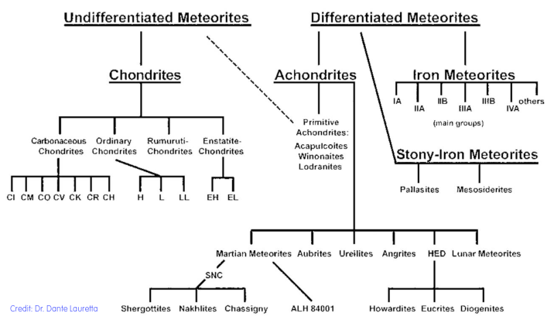
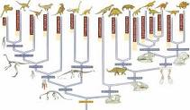
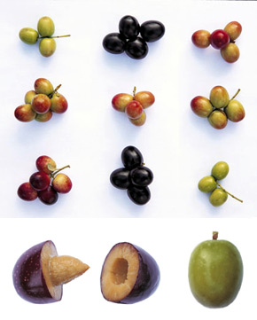
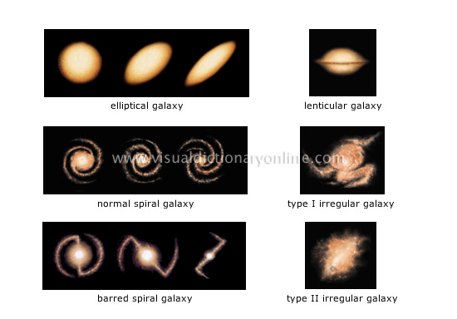
Lecture 3-4: Classification & Clustering

Slide 2
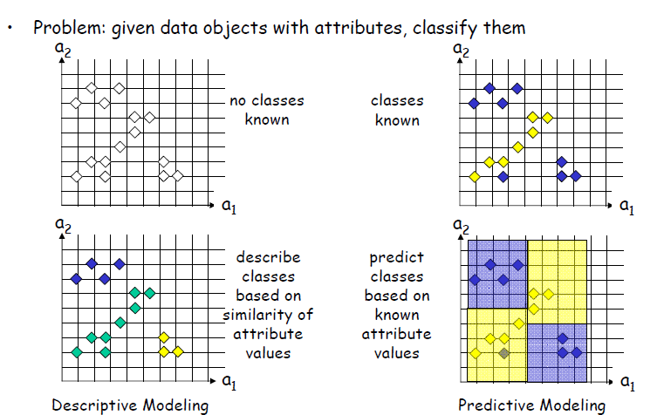
Both operate a partitioning of the parameter space.
Clustering: predictive value Classification: descriptive value

Slide 3
Both clustering and classification aim at partitioning a dataset into subsets that bear similar characteristics.
Different to classification clustering does not assume any prior knowledge, which are the classes/clusters to be searched for. Class label attributes (even when they do exist) are not used in the training phase.
Clustering serves in particular for exploratory data analysis with little or no prior knowledge.
Classification requires samples of templates (i.e. sets of objects with well measured target value). This set is also called Knowledge Base (KB)

Slide 4
Logical structure of a Clustering problem
Given: database D with N d-dimensional data items
Find: partitioning into k clusters and noise
• A good clustering method will produce high quality clusters with
– high intra-class similarity
– low inter-class similarity
The quality of a clustering result depends on both the similarity measure used by the method and its implementation
Inter-cluster distances are maximized
Intra-cluster distances are minimized

Slide 5
Notion of Cluster can be Ambiguous
How many clusters?
Six Clusters
Two Clusters
Four Clusters

Slide 6
Types of Clusterings
Important distinction between hierarchical and partitional sets of clusters
Partitional Clustering
  A division data objects into non-overlapping subsets (clusters) such that each data object is in exactly one subset
Hierarchical clustering
  A set of nested clusters organized as a hierarchical tree
A Partitional Clustering
Original Points

Slide 7
Hierarchical Clustering
Traditional Hierarchical Clustering
Traditional Dendrogram
Non-traditional Hierarchical Clustering
Non-traditional Dendrogram

Slide 8
Other Distinctions Between Sets of Clusters
Exclusive versus non-exclusive
  In non-exclusive clusterings, points may belong to multiple clusters.
  Can represent multiple classes or ‘border’ points
Fuzzy versus non-fuzzy
  In fuzzy clustering, a point belongs to every cluster with some weight between 0 and 1
  Weights must sum to 1
  Probabilistic clustering has similar characteristics
Partial versus complete
  In some cases, we only want to cluster some of the data
Heterogeneous versus homogeneous
  Cluster of widely different sizes, shapes, and densities

Slide 9
Types of Clusters
Well-separated clusters
Center-based clusters
Contiguous clusters
Density-based clusters
Property or Conceptual
Described by an Objective Function

Slide 10
Types of Clusters: Well-Separated
Well-Separated Clusters:
  A cluster is a set of points such that any point in a cluster is closer (or more similar) to every other point in the cluster than to any point not in the cluster.
3 well-separated clusters

Slide 11
Types of Clusters: Center-Based
Center-based
  A cluster is a set of objects such that an object in a cluster is closer (more similar) to the “center” of a cluster, than to the center of any other cluster
  The center of a cluster is often a centroid, the average of all the points in the cluster, or a medoid, the most “representative” point of a cluster
4 center-based clusters

Slide 12
Types of Clusters: Contiguity-Based
Contiguous Cluster (Nearest neighbor or Transitive)
  A cluster is a set of points such that a point in a cluster is closer (or more similar) to one or more other points in the cluster than to any point not in the cluster.
8 contiguous clusters

Slide 13
Types of Clusters: Density-Based
Density-based
  A cluster is a dense region of points, which is separated by low-density regions, from other regions of high density.
  Used when the clusters are irregular or intertwined, and when noise and outliers are present.
6 density-based clusters

Slide 14
Types of Clusters: Conceptual Clusters
Shared Property or Conceptual Clusters
  Finds clusters that share some common property or represent a particular concept.
  .
2 Overlapping Circles

Slide 15
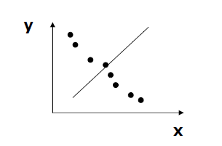
Clustering is essentially a projection business:
(find the projection (feature reduction) which minimizes the distance/similarity between data points)

Slide 16
Questions to ask before picking up a method
Quantitative Criteria
    Scalability: number of data objects N
    High dimensionality
We want to deal with large and complex (high D) data sets. High D increases sparseness of the data. The number of choices for projection dimensions grows combinatorially with D.
Qualitative criteria
    Ability to deal with different types of attributes
    Discovery of clusters with arbitrary shape
Addresses the ability of dealing with continuous as well as
categorical attributes, and the type of clusters that can be found.
Many clustering methods can detect only very simple geometrical shapes, like spheres, hyperplanes, hyperspheres, ellipsoids, etc.

Slide 17
Robustness
    Able to deal with noise and outliers
    Insensitive to order of input records
Clustering methods can be sensitive both to noisy data and the order of how the records are processed. In both cases it would be undesireable to have a dependency of the clustering result on these aspects which are unrelated to the nature of data in question.
Usage-oriented criteria
    Incorporation of user-specified constraints
    Interpretability and usability
a clustering method can incorporate user requirements both in terms of information that is provided from the user to the clustering method (in terms of constraints), which can guide the clustering process, and in terms of what information is provided from the method to the user.

Slide 18
Partitioning Methods are a basic approach to clustering.
Partitioning methods attempt to partition the data set into a given number k of clusters optimizing intracluster similarity and inter-cluster dissimilarity.
Construct a partition of a database D of n objects into a set of k clusters, k predefined.
Given k, find a partition of k clusters that optimizes the chosen
Partitioning criterion
Globally optimal: exhaustively enumerate all partitions
Heuristic methods: k-means and k-medoids algorithms
  k-means: each cluster is represented by the center of the cluster
  k-medoids or PAM (Partition around medoids): each cluster is represented by one of the objects in the cluster

Slide 19
Types of Clusters: Objective Function
Clusters Defined by an Objective Function
  Finds clusters that minimize or maximize an objective function.
  Enumerate all possible ways of dividing the points into clusters and evaluate the `goodness' of each potential set of clusters by using the given objective function. (NP Hard)
  Can have global or local objectives.
    Hierarchical clustering algorithms typically have local objectives
    Partitional algorithms typically have global objectives
  A variation of the global objective function approach is to fit the data to a parametrized data model.
    Parameters for the model are determined from the data.
    Mixture models assume that the data is a ‘mixture' of a number of statistical distributions.

Slide 20
Types of Clusters: Objective Function …
Map the clustering problem to a different domain and solve a related problem in that domain
  Proximity matrix defines a weighted graph, where the nodes are the points being clustered, and the weighted edges represent the proximities between points
  Clustering is equivalent to breaking the graph into connected components, one for each cluster.
  Want to minimize the edge weight between clusters and maximize the edge weight within clusters

Slide 21
Characteristics of the Input Data Are Important
Type of proximity or density measure
  This is a derived measure, but central to clustering
Sparseness
  Dictates type of similarity
  Adds to efficiency
Attribute type
  Dictates type of similarity
Type of Data
  Dictates type of similarity
  Other characteristics, e.g., autocorrelation
Dimensionality
Noise and Outliers
Type of Distribution

Slide 22
The k-Means Partitioning Method
Assume objects are characterized by a d-dimensional vector
Given k, the k-means algorithm is implemented in 4 steps
Step 1: Partition objects into k nonempty subsets
Step 2: Compute seed points as the centroids of the clusters of the current partition. The centroid is the center (mean point) of the cluster.
Step 3: Assign each object to the cluster with the nearest seed point
Step 4: Stop when no new assignment occurs, otherwise go back to Step 2

Slide 23
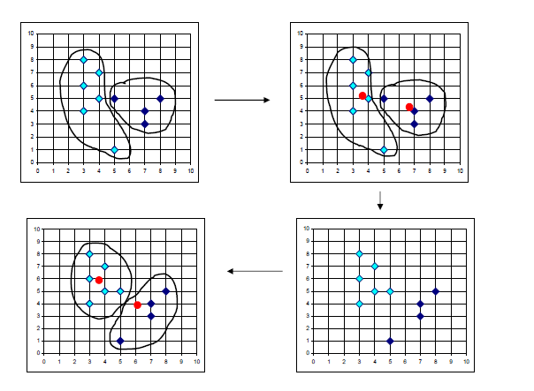

Slide 24
Properties of k-Means
Strengths
Relatively efficient: O(tkn), where n is # objects, k is # clusters, and t is # iterations. Normally, k, t << n.
Often terminates at a local optimum, depending on seed point
The global optimum may be found using techniques such as: deterministic annealing and genetic algorithms
Weaknesses
Applicable only when mean is defined, therefore not applicable to categorical data
Need to specify k, the number of clusters, in advance
Unable to handle noisy data and outliers
Not suitable to discover clusters with non-convex shapes

Slide 25
Two different K-means Clusterings
Original Points
Optimal Clustering
Sub-optimal Clustering

Slide 26
Importance of Choosing Initial Centroids

Slide 27
Importance of Choosing Initial Centroids

Slide 28
Evaluating K-means Clusters
Most common measure is Sum of Squared Error (SSE)
  For each point, the error is the distance to the nearest cluster
  To get SSE, we square these errors and sum them.
  x is a data point in cluster C_{i} and m_{i} is the representative point/center for cluster C_{i}
  Given two clusters, we can choose the one with the smallest error
  One easy way to reduce SSE is to increase K, the number of clusters
    A good clustering with smaller K can have a lower SSE than a poor clustering with higher K

Slide 29
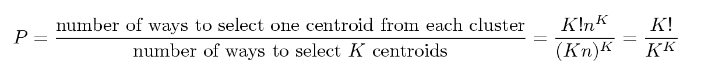
Problems with Selecting Initial Points
If there are K ‘real’ clusters then the chance of selecting one centroid from each cluster is small (decreases with K)
  If clusters are the same size, n, then
  For example, if K = 10, then probability = 10!/10¹⁰ = 0.00036
  Sometimes the initial centroids will readjust themselves in ‘right’ way, and sometimes they don’t
  Consider an example of five pairs of clusters

Slide 30
10 Clusters Example
Starting with two initial centroids in one cluster of each pair of clusters

Slide 31
10 Clusters Example
Starting with two initial centroids in one cluster of each pair of clusters

Slide 32
10 Clusters Example
Starting with some pairs of clusters having three initial centroids, while other have only one.

Slide 33
Solutions to Initial Centroids Problem
Multiple runs
  Helps, but probability is not on your side
Sample and use hierarchical clustering to determine initial centroids
Select more than k initial centroids and then select among these initial centroids
  Select most widely separated
Postprocessing
Bisecting K-means
  Not as susceptible to initialization issues

Slide 34
Handling Empty Clusters
Basic K-means algorithm can yield empty clusters
Several strategies
  Choose the point that contributes most to SSE
  Choose a point from the cluster with the highest SSE
  If there are several empty clusters, the above can be repeated several times.

Slide 35
Updating Centers Incrementally
In the basic K-means algorithm, centroids are updated after all points are assigned to a centroid
An alternative is to update the centroids after each assignment (incremental approach)
  Each assignment updates zero or two centroids
  More expensive
  Introduces an order dependency
  Never get an empty cluster
  Can use “weights” to change the impact

Slide 36
Pre-processing and Post-processing
Pre-processing
  Normalize the data
  Eliminate outliers
Post-processing
  Eliminate small clusters that may represent outliers
  Split ‘loose’ clusters, i.e., clusters with relatively high SSE
  Merge clusters that are ‘close’ and that have relatively low SSE
  Can use these steps during the clustering process
    ISODATA

Slide 37
Limitations of K-means
K-means has problems when clusters are of differing
  Sizes
  Densities
  Non-globular shapes
K-means has problems when the data contains outliers.

Slide 38
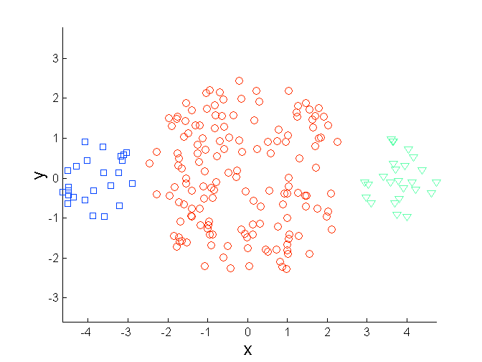
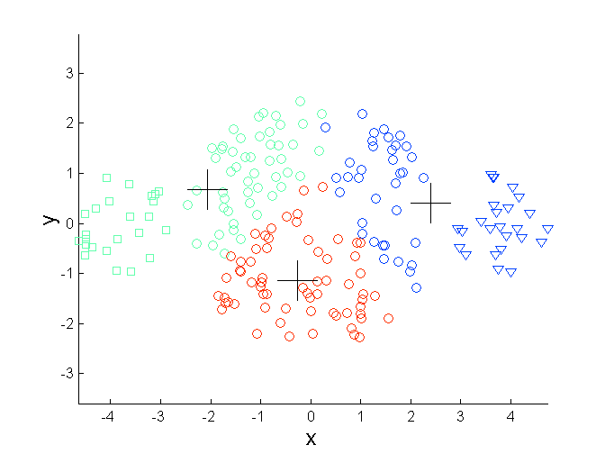
Limitations of K-means: Differing Sizes
Original Points
K-means (3 Clusters)

Slide 39
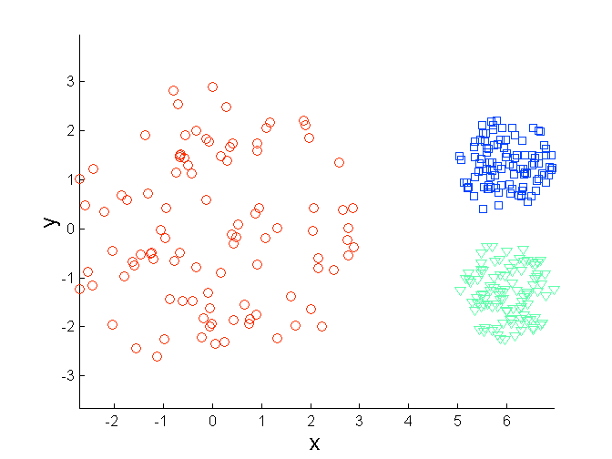
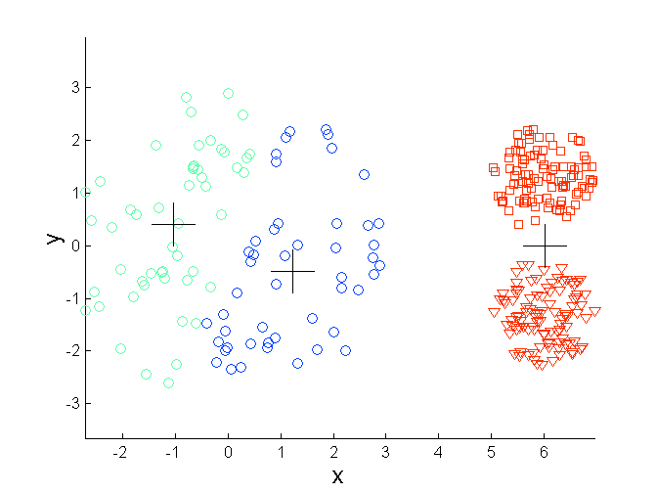
Limitations of K-means: Differing Density
Original Points
K-means (3 Clusters)

Slide 40
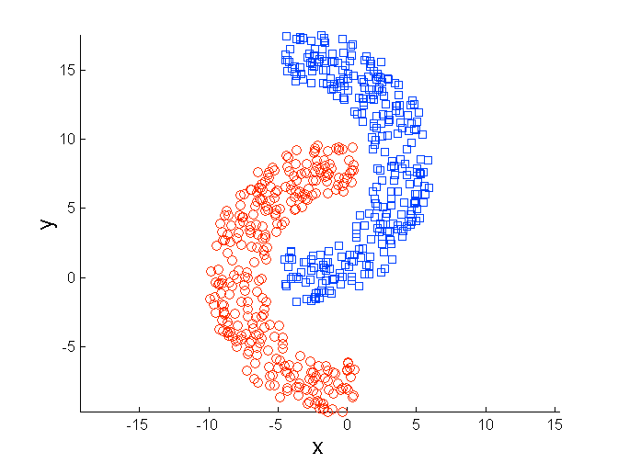
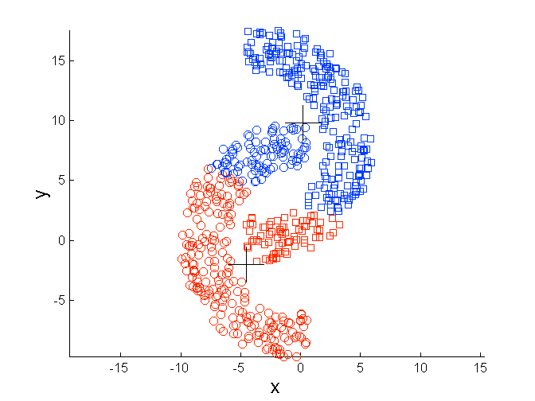
Limitations of K-means: Non-globular Shapes
Original Points
K-means (2 Clusters)

Slide 41
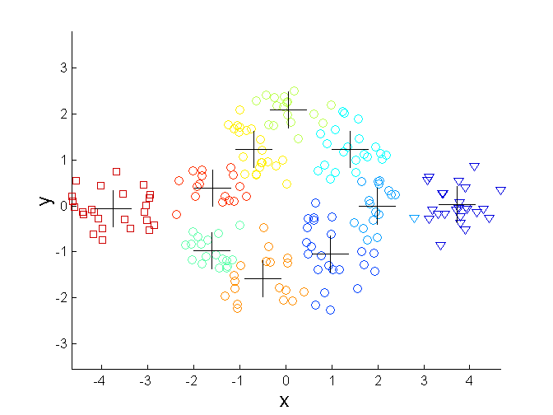
Overcoming K-means Limitations
Original Points K-means Clusters
One solution is to use many clusters.
  Find parts of clusters, but need to put together.

Slide 42
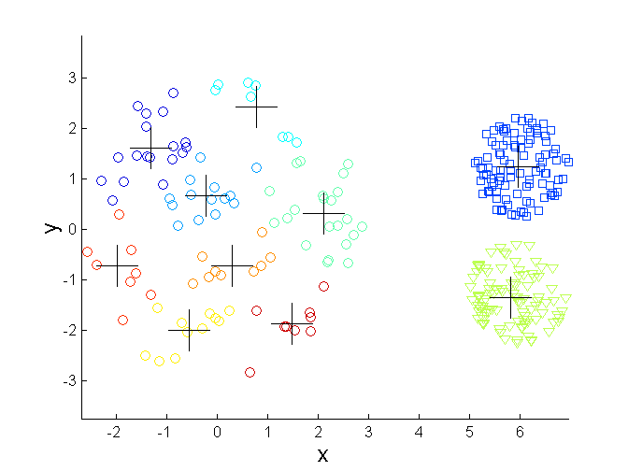
Overcoming K-means Limitations
Original Points K-means Clusters

Slide 43
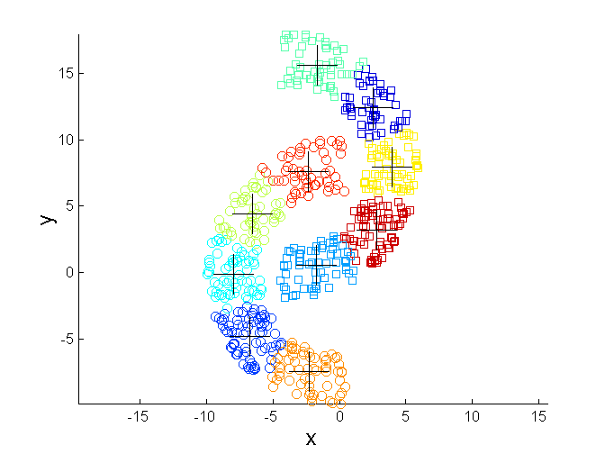
Overcoming K-means Limitations
Original Points K-means Clusters

Slide 44
Hierarchical Clustering
Produces a set of nested clusters organized as a hierarchical tree
Can be visualized as a dendrogram
  A tree like diagram that records the sequences of merges or splits

Slide 45
Strengths of Hierarchical Clustering
Do not have to assume any particular number of clusters
  Any desired number of clusters can be obtained by ‘cutting’ the dendogram at the proper level
They may correspond to meaningful taxonomies
  Example in biological sciences (e.g., animal kingdom, phylogeny reconstruction, …)

Slide 46
Hierarchical Clustering
Two main types of hierarchical clustering
  Agglomerative:
    Start with the points as individual clusters
    At each step, merge the closest pair of clusters until only one cluster (or k clusters) left
  Divisive:
    Start with one, all-inclusive cluster
    At each step, split a cluster until each cluster contains a point (or there are k clusters)
Traditional hierarchical algorithms use a similarity or distance matrix
  Merge or split one cluster at a time

Slide 47
Agglomerative Clustering Algorithm
More popular hierarchical clustering technique
Basic algorithm is straightforward
  Compute the proximity matrix
  Let each data point be a cluster
  Repeat
  Merge the two closest clusters
  Update the proximity matrix
  Until only a single cluster remains
Key operation is the computation of the proximity of two clusters
  Different approaches to defining the distance between clusters distinguish the different algorithms

Slide 48
How to Define Inter-Cluster Similarity
p1
p2
p3
p4
p5
. . .
p1
Similarity?
p2
p3
p4
p5
MIN
MAX
Group Average
Distance Between Centroids
Other methods driven by an objective function
  Ward’s Method uses squared error
.
.
.
Proximity Matrix

Slide 49
How to Define Inter-Cluster Similarity
p1
p2
p3
p4
p5
. . .
p1
p2
p3
p4
p5
MIN
MAX
Group Average
Distance Between Centroids
Other methods driven by an objective function
  Ward’s Method uses squared error
.
.
.
Proximity Matrix

Slide 50
How to Define Inter-Cluster Similarity
p1
p2
p3
p4
p5
. . .
p1
p2
p3
p4
p5
MIN
MAX
Group Average
Distance Between Centroids
Other methods driven by an objective function
  Ward’s Method uses squared error
.
.
.
Proximity Matrix

Slide 51
How to Define Inter-Cluster Similarity
p1
p2
p3
p4
p5
. . .
p1
p2
p3
p4
p5
MIN
MAX
Group Average
Distance Between Centroids
Other methods driven by an objective function
  Ward’s Method uses squared error
.
.
.
Proximity Matrix

Slide 52
How to Define Inter-Cluster Similarity
p1
p2
p3
p4
p5
. . .
p1
×
×
p2
p3
p4
p5
MIN
MAX
Group Average
Distance Between Centroids
Other methods driven by an objective function
  Ward’s Method uses squared error
.
.
.
Proximity Matrix

Slide 53
Cluster Similarity: MIN or Single Link
Similarity of two clusters is based on the two most similar (closest) points in the different clusters
  Determined by one pair of points, i.e., by one link in the proximity graph.
1
2
3
4
5

Slide 54
Hierarchical Clustering: MIN
5
1
3
5
2
1
2
3
6
4
4
Nested Clusters
Dendrogram

Slide 55
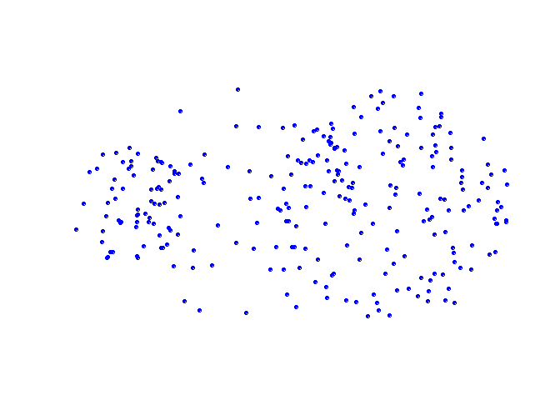
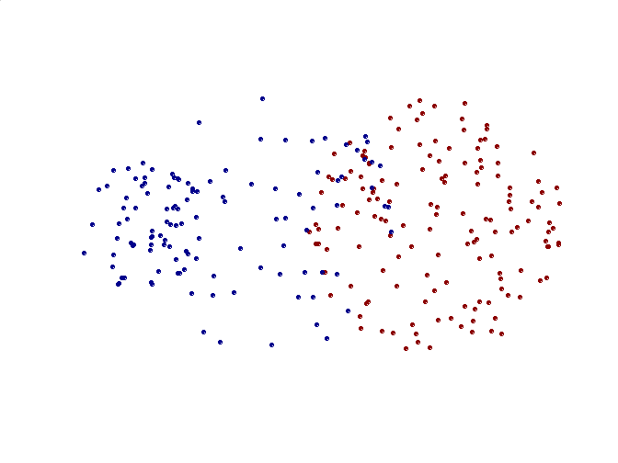
Limitations of MIN
Original Points
Two Clusters
Sensitive to noise and outliers

Slide 56
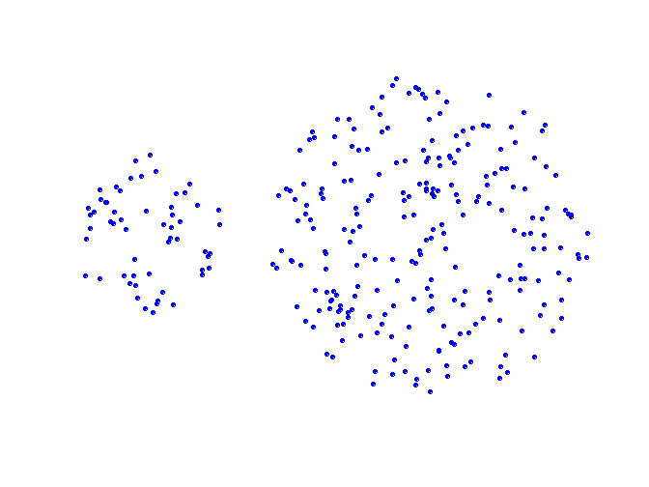
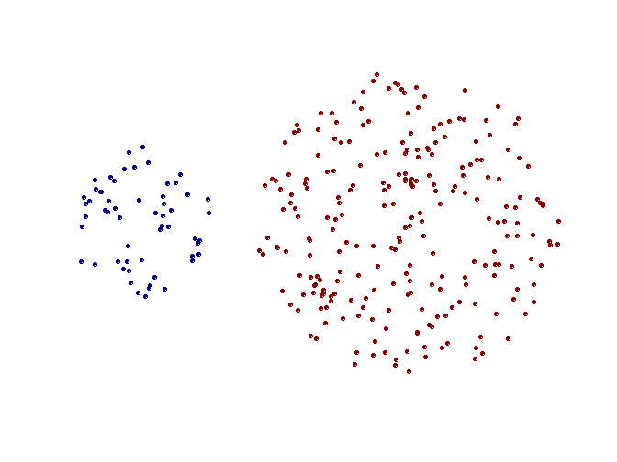
Strength of MIN
Original Points
Two Clusters
Can handle non-elliptical shapes

Slide 57
Cluster Similarity: MAX or Complete Linkage
Similarity of two clusters is based on the two least similar (most distant) points in the different clusters
  Determined by all pairs of points in the two clusters
1
2
3
4
5

Slide 58
Hierarchical Clustering: MAX
4
1
2
5
5
2
3
6
3
1
4
Nested Clusters
Dendrogram

Slide 59
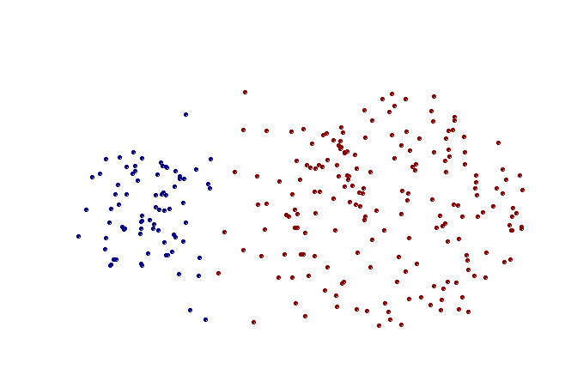
Strength of MAX
Original Points
Two Clusters
Less susceptible to noise and outliers

Slide 60
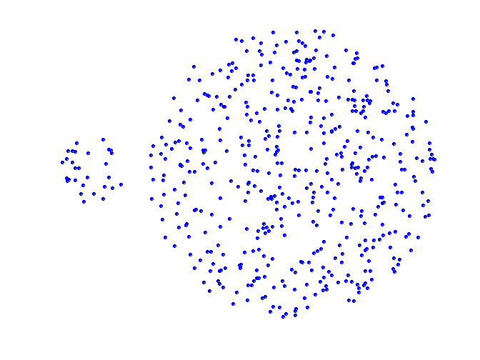
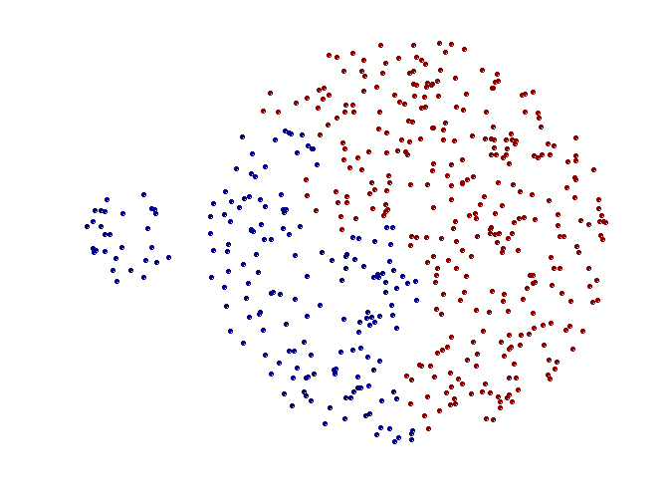
Limitations of MAX
Original Points
Two Clusters
Tends to break large clusters
Biased towards globular clusters

Slide 61
Cluster Similarity: Group Average
Proximity of two clusters is the average of pairwise proximity between points in the two clusters.
Need to use average connectivity for scalability since total proximity favors large clusters
1
2
3
4
5

Slide 62
Hierarchical Clustering: Group Average
5
4
1
2
5
2
3
6
1
4
3
Nested Clusters
Dendrogram

Slide 63
Hierarchical Clustering: Group Average
Compromise between Single and Complete Link
Strengths
  Less susceptible to noise and outliers
Limitations
  Biased towards globular clusters

Slide 64
Cluster Similarity: Ward’s Method
Similarity of two clusters is based on the increase in squared error when two clusters are merged
  Similar to group average if distance between points is distance squared
Less susceptible to noise and outliers
Biased towards globular clusters
Hierarchical analogue of K-means
  Can be used to initialize K-means

Slide 65
Hierarchical Clustering: Comparison
5
1
4
1
3
2
5
5
5
2
1
MIN
2
MAX
2
3
6
3
3
6
1
4
4
4
5
5
1
4
1
2
2
5
2
Ward’s Method
5
2
3
6
Group Average
3
3
6
4
1
1
4
4
3

Slide 66
Hierarchical Clustering: Time and Space requirements
O(N²) space since it uses the proximity matrix.
  N is the number of points.
O(N³) time in many cases
  There are N steps and at each step the size, N², proximity matrix must be updated and searched
  Complexity can be reduced to O(N² log(N) ) time for some approaches

Slide 67
Hierarchical Clustering: Problems and Limitations
Once a decision is made to combine two clusters, it cannot be undone
No objective function is directly minimized
Different schemes have problems with one or more of the following:
  Sensitivity to noise and outliers
  Difficulty handling different sized clusters and convex shapes
  Breaking large clusters

Slide 68
DBSCAN
DBSCAN is a density-based algorithm.
  Density = number of points within a specified radius (Eps)
  A point is a core point if it has more than a specified number of points (MinPts) within Eps
    These are points that are at the interior of a cluster
  A border point has fewer than MinPts within Eps, but is in the neighborhood of a core point
  A noise point is any point that is not a core point or a border point.

Slide 69
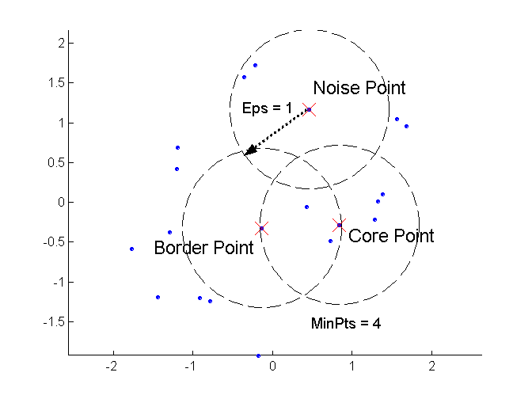
DBSCAN: Core, Border, and Noise Points

Slide 70
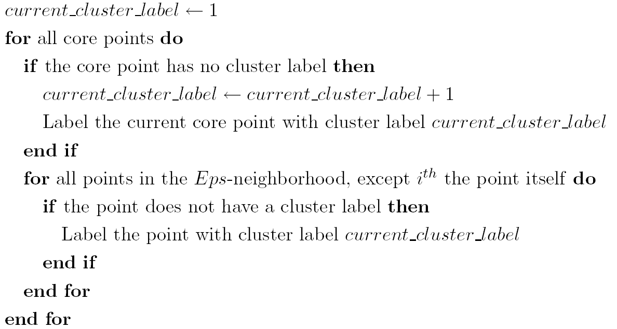
DBSCAN Algorithm
Eliminate noise points
Perform clustering on the remaining points

Slide 71
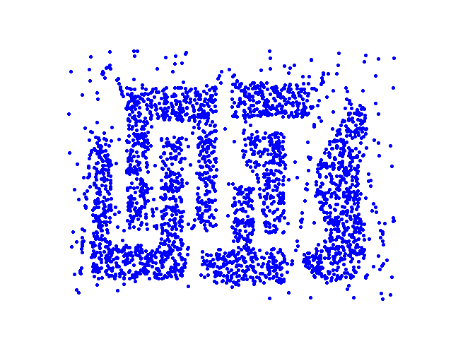
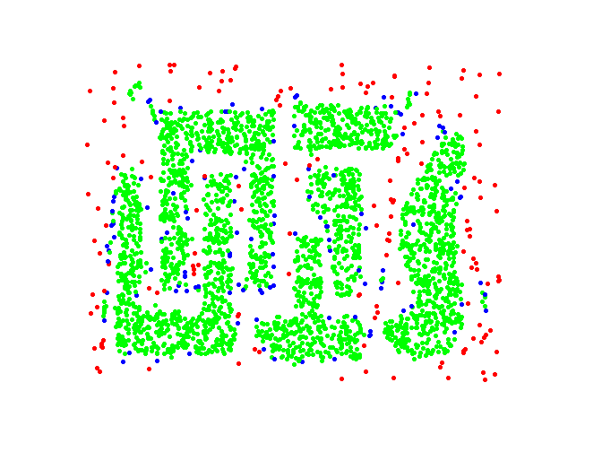
DBSCAN: Core, Border and Noise Points
Original Points
Point types: core, border and noise
Eps = 10, MinPts = 4

Slide 72
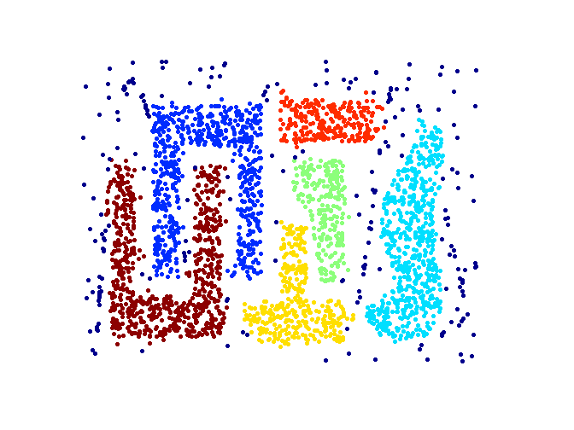
When DBSCAN Works Well
Original Points
Clusters
Resistant to Noise
Can handle clusters of different shapes and sizes

Slide 73
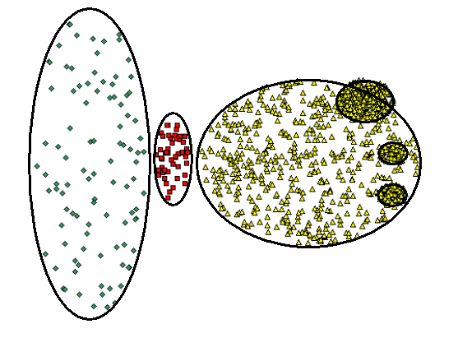
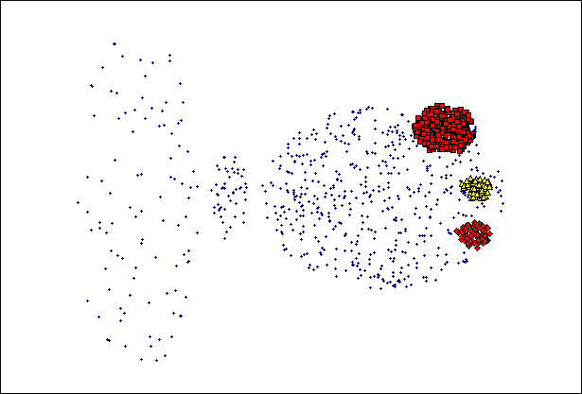
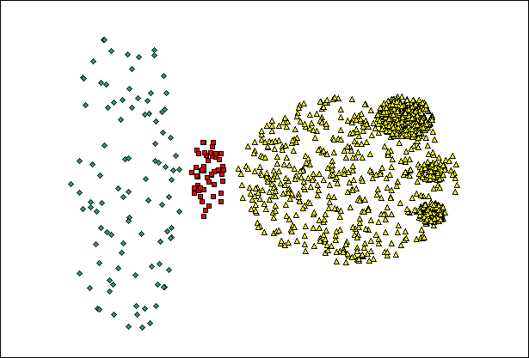
When DBSCAN Does NOT Work Well
(MinPts=4, Eps=9.75).
Original Points
Varying densities
High-dimensional data
(MinPts=4, Eps=9.92)

Slide 74
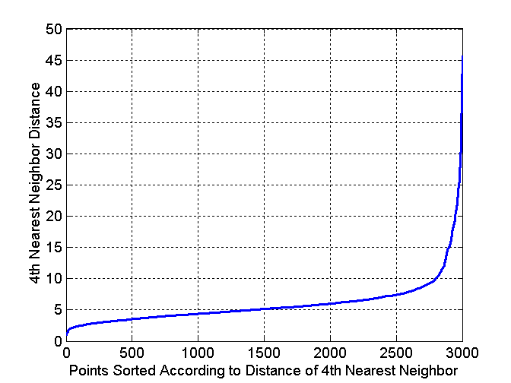
DBSCAN: Determining EPS and MinPts
Idea is that for points in a cluster, their k^{th} nearest neighbors are at roughly the same distance
Noise points have the k^{th} nearest neighbor at farther distance
So, plot sorted distance of every point to its k^{th} nearest neighbor

Slide 75
Cluster Validity
For supervised classification we have a variety of measures to evaluate how good our model is
  Accuracy, precision, recall
For cluster analysis, the analogous question is how to evaluate the “goodness” of the resulting clusters?
But “clusters are in the eye of the beholder”!
Then why do we want to evaluate them?
  To avoid finding patterns in noise
  To compare clustering algorithms
  To compare two sets of clusters
  To compare two clusters

Slide 76
Clusters found in Random Data
Random Points
DBSCAN
K-means
Complete Link

Slide 77
Different Aspects of Cluster Validation
Determining the clustering tendency of a set of data, i.e., distinguishing whether non-random structure actually exists in the data.
Comparing the results of a cluster analysis to externally known results, e.g., to externally given class labels.
Evaluating how well the results of a cluster analysis fit the data without reference to external information.
  - Use only the data
Comparing the results of two different sets of cluster analyses to determine which is better.
Determining the ‘correct’ number of clusters.
For 2, 3, and 4, we can further distinguish whether we want to evaluate the entire clustering or just individual clusters.

Slide 78
Measures of Cluster Validity
Numerical measures that are applied to judge various aspects of cluster validity, are classified into the following three types.
  External Index: Used to measure the extent to which cluster labels match externally supplied class labels.
    Entropy
  Internal Index: Used to measure the goodness of a clustering structure without respect to external information.
    Sum of Squared Error (SSE)
  Relative Index: Used to compare two different clusterings or clusters.
    Often an external or internal index is used for this function, e.g., SSE or entropy
Sometimes these are referred to as criteria instead of indices
  However, sometimes criterion is the general strategy and index is the numerical measure that implements the criterion.

Slide 79
Measuring Cluster Validity Via Correlation
Two matrices
  Proximity Matrix
  “Incidence” Matrix
    One row and one column for each data point
    An entry is 1 if the associated pair of points belong to the same cluster
    An entry is 0 if the associated pair of points belongs to different clusters
Compute the correlation between the two matrices
  Since the matrices are symmetric, only the correlation between
  n(n-1) / 2 entries needs to be calculated.
High correlation indicates that points that belong to the same cluster are close to each other.
Not a good measure for some density or contiguity based clusters.

Slide 80
Measuring Cluster Validity Via Correlation
Correlation of incidence and proximity matrices for the K-means clusterings of the following two data sets.
Corr = -0.9235
Corr = -0.5810

Slide 81
Using Similarity Matrix for Cluster Validation
Order the similarity matrix with respect to cluster labels and inspect visually.

Slide 82
Using Similarity Matrix for Cluster Validation
Clusters in random data are not so crisp
DBSCAN

Slide 83
Using Similarity Matrix for Cluster Validation
Clusters in random data are not so crisp
K-means

Slide 84
Using Similarity Matrix for Cluster Validation
Clusters in random data are not so crisp
Complete Link

Slide 85
Using Similarity Matrix for Cluster Validation
DBSCAN

Slide 86
Internal Measures: SSE
Clusters in more complicated figures aren’t well separated
Internal Index: Used to measure the goodness of a clustering structure without respect to external information
  SSE
SSE is good for comparing two clusterings or two clusters (average SSE).
Can also be used to estimate the number of clusters

Slide 87
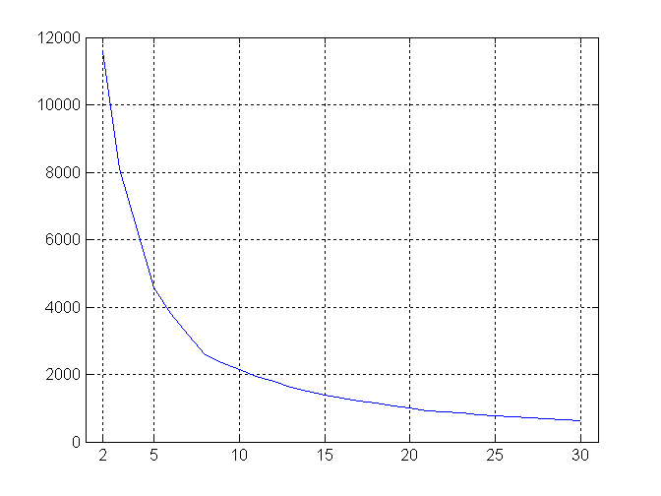
Internal Measures: SSE
SSE curve for a more complicated data set
SSE of clusters found using K-means

Slide 88
Framework for Cluster Validity
Need a framework to interpret any measure.
  For example, if our measure of evaluation has the value, 10, is that good, fair, or poor?
Statistics provide a framework for cluster validity
  The more “atypical” a clustering result is, the more likely it represents valid structure in the data
  Can compare the values of an index that result from random data or clusterings to those of a clustering result.
    If the value of the index is unlikely, then the cluster results are valid
  These approaches are more complicated and harder to understand.
For comparing the results of two different sets of cluster analyses, a framework is less necessary.
  However, there is the question of whether the difference between two index values is significant

Slide 89
Statistical Framework for SSE
Example
  Compare SSE of 0.005 against three clusters in random data
  Histogram shows SSE of three clusters in 500 sets of random data points of size 100 distributed over the range 0.2 – 0.8 for x and y values

Slide 90
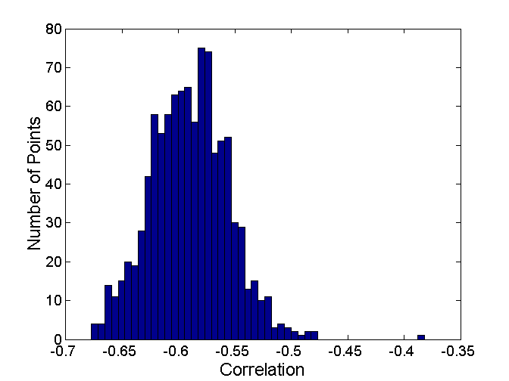
Statistical Framework for Correlation
Correlation of incidence and proximity matrices for the K-means clusterings of the following two data sets.
Corr = -0.9235
Corr = -0.5810

Slide 91
Internal Measures: Cohesion and Separation
Cluster Cohesion: Measures how closely related are objects in a cluster
  Example: SSE
Cluster Separation: Measure how distinct or well-separated a cluster is from other clusters
Example: Squared Error
  Cohesion is measured by the within cluster sum of squares (SSE)
  Separation is measured by the between cluster sum of squares
      Where |C_{i}| is the size of cluster i

Slide 92
Internal Measures: Cohesion and Separation
Example: SSE
  BSS + WSS = constant
m
×
×
×
1
m₁
2
3
4
m₂
5
K=1 cluster:
K=2 clusters:

Slide 93
Internal Measures: Cohesion and Separation
A proximity graph based approach can also be used for cohesion and separation.
  Cluster cohesion is the sum of the weight of all links within a cluster.
  Cluster separation is the sum of the weights between nodes in the cluster and nodes outside the cluster.
cohesion
separation

Slide 94
Internal Measures: Silhouette Coefficient
Silhouette Coefficient combine ideas of both cohesion and separation, but for individual points, as well as clusters and clusterings
For an individual point, i
  Calculate a = average distance of i to the points in its cluster
  Calculate b = min (average distance of i to points in another cluster)
  The silhouette coefficient for a point is then given by
  s = 1 – a/b if a < b, (or s = b/a - 1 if a ≥ b, not the usual case)
  Typically between 0 and 1.
  The closer to 1 the better.
Can calculate the Average Silhouette width for a cluster or a clustering

Slide 95
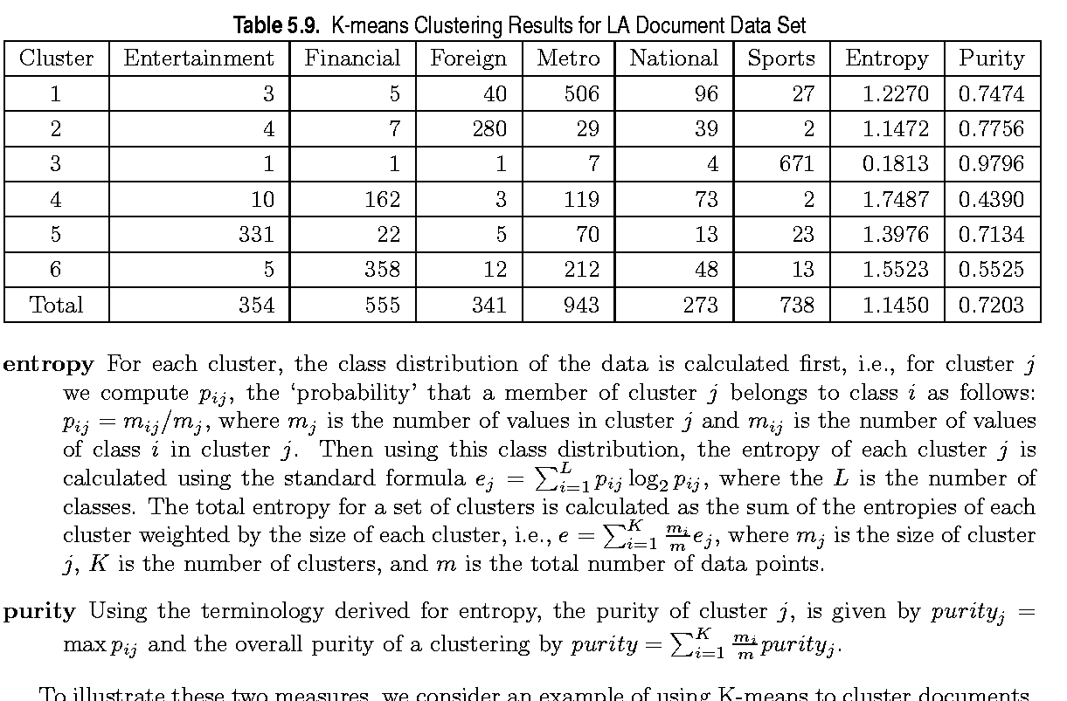
External Measures of Cluster Validity: Entropy and Purity

Slide 96
Final Comment on Cluster Validity
“The validation of clustering structures is the most difficult and frustrating part of cluster analysis.
Without a strong effort in this direction, cluster analysis will remain a black art accessible only to those true believers who have experience and great courage.”
Algorithms for Clustering Data, Jain and Dubes

Slide 97
Classification
Data: tuples with multiple categorical and quantitative attributes and at least one categorical attribute (the class label attribute)
Classification
  Predicts categorical class labels
  Classifies data (constructs a model) based on a training set and the values (class labels) in a class label attribute
  Uses the model in classifying new data
Prediction/Regression
  models continuous-valued functions, i.e., predicts unknown or missing values

Slide 98
Classification Process
Model: describing a set of predetermined classes
Each tuple/sample is assumed to belong to a predefined class based on its attribute values
The class is determined by the class label attribute
The set of tuples used for model construction: training set
The model is represented as classification rules, decision trees, or mathematical formulae
Model usage: for classifying future or unknown data
Estimate accuracy of the model using a test set
Test set is independent of training set, otherwise over-fitting (in same cases an additional validation set is needed) occurs
The known label of the test set sample is compared with the classified result from the model
Accuracy rate is the percentage of test set samples that are correctly classified by the model

Slide 99
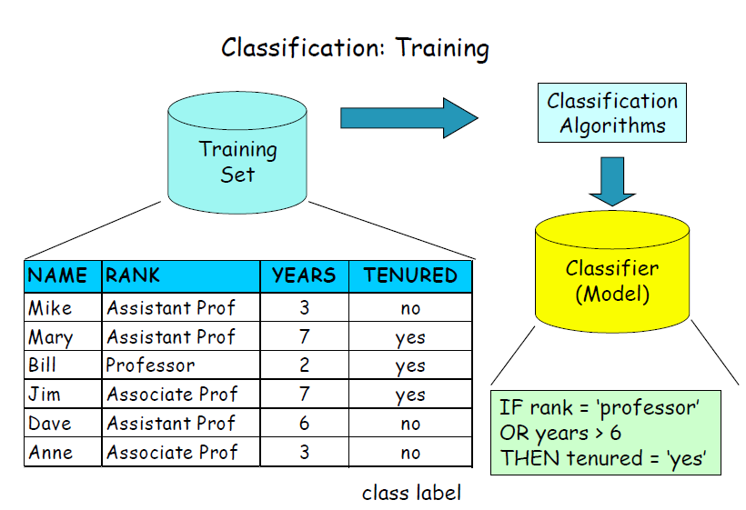

Slide 100
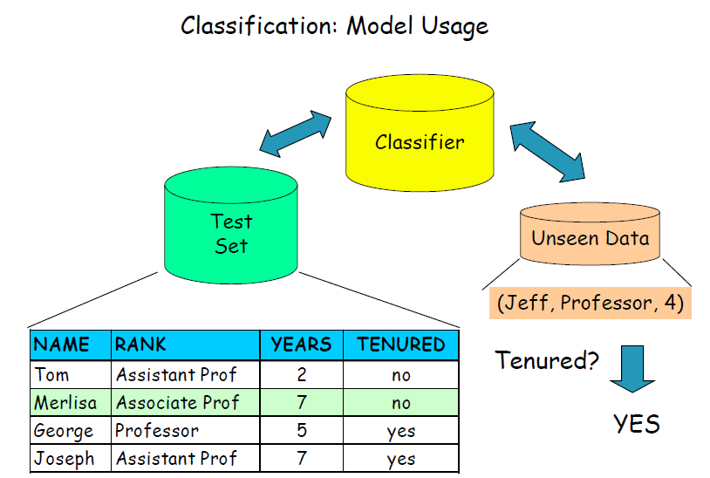

Slide 101
Classification Techniques
Decision Tree based Methods
Rule-based Methods
Memory based reasoning
Neural Networks
Naïve Bayes and Bayesian Belief Networks
Support Vector Machines

Slide 102
Criteria for Classification Methods
Predictive accuracy
  Speed and scalability
  time to construct the model
  time to use the model
  efficiency in disk-resident databases
Robustness
  handling noise and missing values
Interpretability
  understanding and insight provided by the model
Goodness of rules
  decision tree size
  compactness of classification rules

Slide 103
Classification by Decision Tree Induction
Decision tree
  A flow-chart-like tree structure
  Internal node denotes a test on a single attribute
  Branch represents an outcome of the test
  Leaf nodes represent class labels or class distribution
Use of decision tree: Classifying an unknown sample
Test the attribute values of the sample against the decision tree

Slide 104
Generally a decision tree is first constructed in a top-down manner by recursively splitting the training set using conditions on the attributes.
How these conditions are found is one of the key issues of decision tree induction.
Decision tree generation consists of two phases
  Tree construction
    At start, all the training samples are at the root
    Partition samples recursively based on selected attributes
After the tree construction it usually is the case that at the leaf level the granularity is too fine, i.e. many leaves represent some kind of exceptional data.
  Tree pruning
    Identify and remove branches that reflect noise or outliers
Thus in a second phase such leaves are identified and eliminated.

Slide 105
attribute values of an unknown sample are tested against the conditions in the tree nodes, and the class is derived from the class of the leaf node at which the sample arrives.
Decision Tree

Slide 106
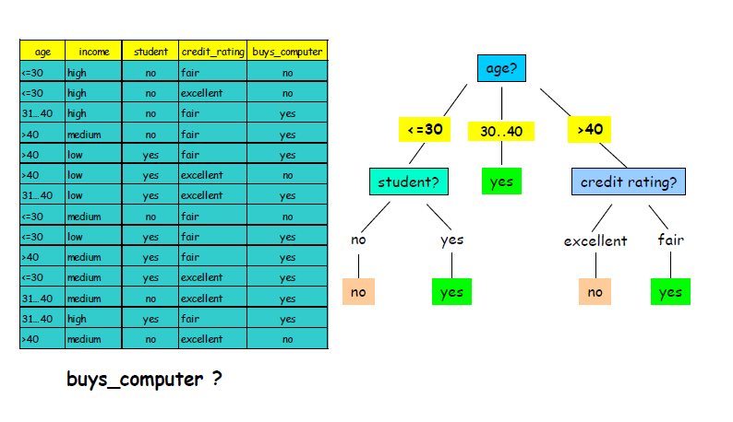

Slide 107
Algorithm for Decision Tree Construction
Basic algorithm for categorical attributes (greedy)
The tree is constructed in a top-down recursive divide-and-conquer manner
At start, all the training samples are at the root
Examples are partitioned recursively based on test attributes
Test attributes are selected on the basis of a heuristic or statistical measure (e.g., information gain)
Conditions for stopping partitioning
All samples for a given node belong to the same class
There are no remaining attributes for further partitioning – majority voting is employed for classifying the leaf
There are no samples left
Attribute Selection Measure
Information Gain

Slide 108
Decision Tree Induction
Many Algorithms:
  Hunt’s Algorithm (one of the earliest)
  CART
  ID3, C4.5
  SLIQ,SPRINT

Slide 109
Tree Induction
Greedy strategy.
  Split the records based on an attribute test that optimizes certain criterion.
Issues
  Determine how to split the records
    How to specify the attribute test condition?
    How to determine the best split?
  Determine when to stop splitting

Slide 110
How to Specify Test Condition?
Depends on attribute types
  Nominal
  Ordinal
  Continuous
Depends on number of ways to split
  2-way split
  Multi-way split

Slide 111
Splitting Based on Nominal Attributes
Multi-way split: Use as many partitions as distinct values.
Binary split: Divides values into two subsets.
Need to find optimal partitioning.
CarType
Family
Luxury
Sports
CarType
CarType
{Sports, Luxury}
OR
{Family,
Luxury}
{Family}
{Sports}

Slide 112
Splitting Based on Ordinal Attributes
Multi-way split: Use as many partitions as distinct values.
Binary split: Divides values into two subsets.
Need to find optimal partitioning.
What about this split?
Size
Small
Large
Medium
Size
Size
{Small, Medium}
OR
{Medium,
Large}
{Large}
{Small}
Size
{Small, Large}
{Medium}

Slide 113
Splitting Based on Continuous Attributes
Different ways of handling
  Discretization to form an ordinal categorical attribute
    Static – discretize once at the beginning
    Dynamic – ranges can be found by equal interval bucketing, equal frequency bucketing
    (percentiles), or clustering.
  Binary Decision: (A < v) or (A ≥ v)
    consider all possible splits and finds the best cut
    can be more compute intensive

Slide 114
Splitting Based on Continuous Attributes

Slide 115
Tree Induction
Greedy strategy.
  Split the records based on an attribute test that optimizes certain criterion.
Issues
  Determine how to split the records
    How to specify the attribute test condition?
    How to determine the best split?
  Determine when to stop splitting

Slide 116
How to determine the Best Split
Before Splitting: 10 records of class 0,
10 records of class 1
Which test condition is the best?

Slide 117
How to determine the Best Split
Greedy approach:
  Nodes with homogeneous class distribution are preferred
Need a measure of node impurity:
Non-homogeneous,
High degree of impurity
Homogeneous,
Low degree of impurity

Slide 118
Measures of Node Impurity
Gini Index
Entropy
Misclassification error

Slide 119
How to split attributes during the construction of a decision tree.
Assuming that we have a binary category, i.e. two classes P and N into which a data collection S needs to be classified
compute the amount of information required to determine the class, by I(p, n), the standard entropy measure, where p and n denote the cardinalities of P and N.
Given an attribute A that can be used for partitioning the data collection in the decision tree, calculate the amount of information needed to classify the data after the split according to attribute A has been performed.

Slide 120
Attribute A partitions S into {S₁, S₂ , …, S_{M}}
If S_{i} contains p_{i} examples of P and n_{i} examples of N, the expected information needed to classify objects in all subtrees S_{i} is
calculate I(p, n) for each of the partitions and weight these values by the probability that a data item belongs to the respective partition.
The information gained by a split then can be determined as the difference of the amount of information needed for correct classification before and after the split.
G a in ( A) = I ( p , n ) − E ( A)
Thus we calculate the reduction in uncertainty that is obtained by splitting according to attribute A and select among all possible attributes the one that leads to the highest reduction.

Slide 122
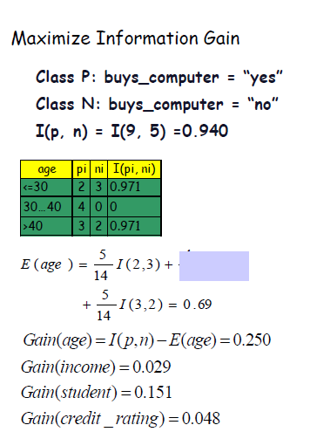

Slide 123
Pruning
Classification reflects "noise" in the data.
It is needed to remove subtrees that are overclassifying
Apply Principle of Minimum Description Length (MDL)
  Find tree that encodes the training set with minimal cost
  Total encoding cost: cost(M, D)
  Cost of encoding data D given a model M: cost(D | M)
  Cost of encoding model M: cost(M)
  cost(M, D) = cost(D | M) + cost(M)
Measuring cost
  For data: count misclassifications
  For model: assume an appropriate encoding of the tree

Slide 124
It is important to recognize that for a test dataset a classifier may overspecialize and
capture noise in the data rather than general properties.
One possiblity to limit overspecialization would be to stop the partitioning of tree nodes when some criteria
is met (e.g. number of samples assigned to the leaf node). However, in general it is
difficult to find a suitable criterion. Another alternative is to first built the fully
grown classification tree, and then in a second phase prune those subtrees that do
not contribute to an efficient classification scheme. Efficiency can be measured in
that case as follows: if the effort in order to specify a class (the implicit description
of the class extension) exceeds the effort to enumerate all class members (the
explicit description of the class extension), then the subtree is overclassifying and
non-optimal. This is called the priniciple of minimum description length. To
measure the description cost a suitable metrics for the encoding cost, both for trees
and data sets is required. For trees this can be done by suitably counting the various
structural elements needed to encode the tree (nodes, test predicates), whereas for
explicit classification, it is sufficient to count the number of misclassifications that
occur in a tree node.

Slide 125
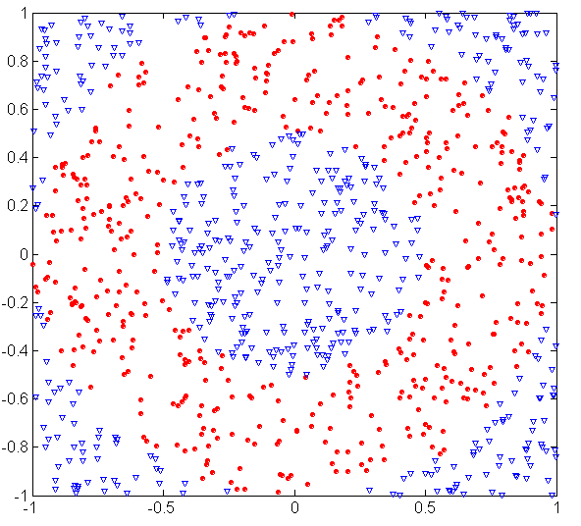
Underfitting and Overfitting (Example)
500 circular and 500 triangular data points.
Circular points:
0.5 ≤ sqrt(x₁²+x₂²) ≤ 1
Triangular points:
sqrt(x₁²+x₂²) > 0.5 or
sqrt(x₁²+x₂²) < 1

Slide 126
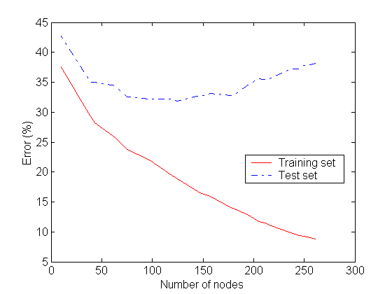
Underfitting and Overfitting
Overfitting
Underfitting: when model is too simple, both training and test errors are large

Slide 127
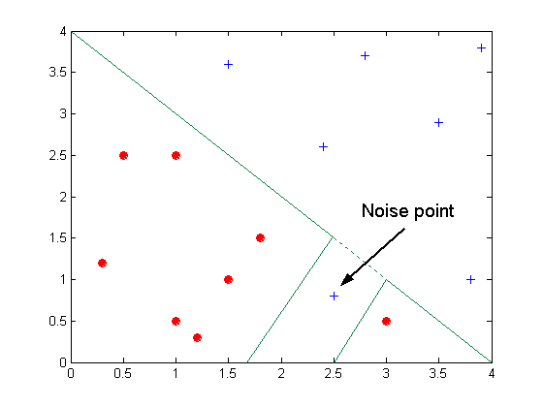
Overfitting due to Noise
Decision boundary is distorted by noise point

Slide 128
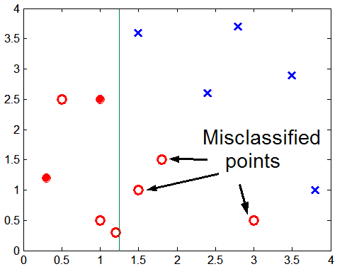
Overfitting due to Insufficient Examples
Lack of data points in the lower half of the diagram makes it difficult to predict correctly the class labels of that region
- Insufficient number of training records in the region causes the decision tree to predict the test examples using other training records that are irrelevant to the classification task

Slide 129
Occam’s Razor
Given two models of similar generalization errors, one should prefer the simpler model over the more complex model
For complex models, there is a greater chance that it was fitted accidentally by errors in data
Therefore, one should include model complexity when evaluating a model

Slide 130
Scalability
Naive implementation
At each step the data set is split and associated with its tree node
Problem with naive implementation
  For evaluating which attribute to split data needs to be sorted according to these attributes
  Becomes dominating cost
Idea : Presorting of data and maintaining order throughout tree construction
  Requires separate sorted attribute tables for each attribute
  Attribute selected for split: splitting attribute table straightforward
  Build Hash Table associating TIDs of selected data items with partitions
  Select data from other attribute tables by scanning and probing the hash table

Slide 131
Instance-Based Classifiers
Store the training records
Use training records to
predict the class label of
unseen cases

Slide 132
Instance Based Classifiers
Examples:
  Rote-learner
    Memorizes entire training data and performs classification only if attributes of record match one of the training examples exactly
  Nearest neighbor
    Uses k “closest” points (nearest neighbors) for performing classification

Slide 133
Nearest Neighbor Classifiers
Basic idea:
  If it walks like a duck, quacks like a duck, then it’s probably a duck
Compute Distance
Test Record
Training Records
Choose k of the “nearest” records

Slide 134
Nearest Neighbor Classification
Compute distance between two points:
  Euclidean distance
Determine the class from nearest neighbor list
  take the majority vote of class labels among the k-nearest neighbors
  Weigh the vote according to distance
    weight factor, w = 1/d²

Slide 135
Nearest-Neighbor Classifiers
Requires three things
  The set of stored records
  Distance Metric to compute distance between records
  The value of k, the number of nearest neighbors to retrieve
To classify an unknown record:
  Compute distance to other training records
  Identify k nearest neighbors
  Use class labels of nearest neighbors to determine the class label of unknown record (e.g., by taking majority vote)

Slide 136
Definition of Nearest Neighbor
K-nearest neighbors of a record x are data points that have the k smallest distance to x

Slide 137
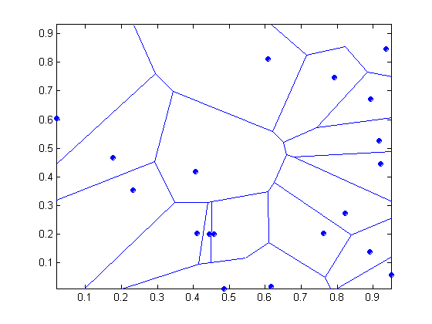
1 nearest-neighbor
Voronoi Diagram

Slide 138
Nearest Neighbor Classification…
Choosing the value of k:
  If k is too small, sensitive to noise points
  If k is too large, neighborhood may include points from other classes

Slide 139
Nearest Neighbor Classification…
Scaling issues
  Attributes may have to be scaled to prevent distance measures from being dominated by one of the attributes
  Example:
    height of a person may vary from 1.5m to 1.8m
    weight of a person may vary from 90lb to 300lb
    income of a person may vary from $10K to $1M

Slide 140
Nearest Neighbor Classification…
Problem with Euclidean measure:
  High dimensional data
    curse of dimensionality
  Can produce counter-intuitive results
1 1 1 1 1 1 1 1 1 1 1 0
1 0 0 0 0 0 0 0 0 0 0 0
vs
0 1 1 1 1 1 1 1 1 1 1 1
0 0 0 0 0 0 0 0 0 0 0 1
d = 1.4142
d = 1.4142
    Solution: Normalize the vectors to unit length

Slide 141
Nearest neighbor Classification…
k-NN classifiers are lazy learners
  It does not build models explicitly
  Unlike eager learners such as decision tree induction and rule-based systems
  Classifying unknown records are relatively expensive

Slide 142
Artificial Neural Networks (ANN)
Output Y is 1 if at least two of the three inputs are equal to 1.

Slide 143
Artificial Neural Networks (ANN)

Slide 144
Artificial Neural Networks (ANN)
Model is an assembly of inter-connected nodes and weighted links
Output node sums up each of its input value according to the weights of its links
Compare output node against some threshold t
Perceptron Model
or

Slide 145
General Structure of ANN
Training ANN means learning the weights of the neurons

Slide 146
Algorithm for learning ANN
Initialize the weights (w₀, w₁, …, w_{k})
Adjust the weights in such a way that the output of ANN is consistent with class labels of training examples
  Objective function:
  Find the weights w_{i}’s that minimize the above objective function

Slide 147
Support Vector Machines
Find a linear hyperplane (decision boundary) that will separate the data

Slide 148
Support Vector Machines
One Possible Solution

Slide 149
Support Vector Machines
Another possible solution

Slide 150
Support Vector Machines
Other possible solutions

Slide 151
Support Vector Machines
Which one is better? B1 or B2?
How do you define better?

Slide 152
Support Vector Machines
Find hyperplane maximizes the margin => B1 is better than B2

Slide 153
Support Vector Machines

Slide 154
Support Vector Machines
We want to maximize:
  Which is equivalent to minimizing:
  But subjected to the following constraints:
    This is a constrained optimization problem
      Numerical approaches to solve it (e.g., quadratic programming)

Slide 155
Support Vector Machines
What if the problem is not linearly separable?

Slide 156
Support Vector Machines
What if the problem is not linearly separable?
  Introduce slack variables
    Need to minimize:
    Subject to:

Slide 157
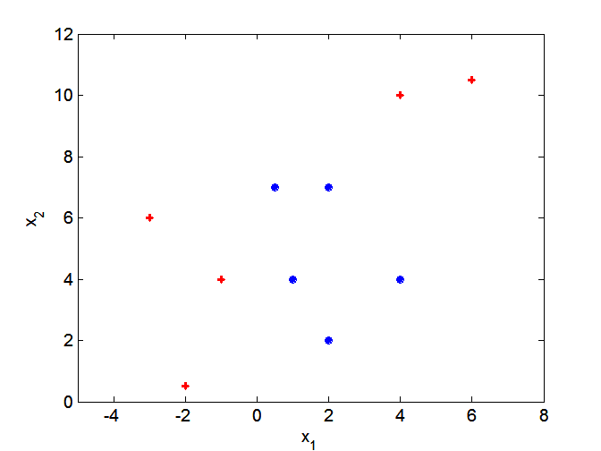
Nonlinear Support Vector Machines
What if decision boundary is not linear?

Slide 158
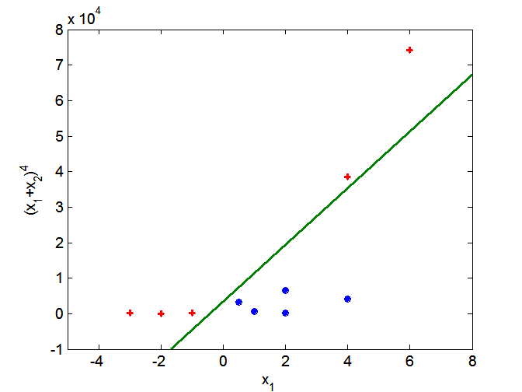
Nonlinear Support Vector Machines
Transform data into higher dimensional space

Slide 159
Ensemble Methods
Construct a set of classifiers from the training data
Predict class label of previously unseen records by aggregating predictions made by multiple classifiers

Slide 160
General Idea

Slide 161
Why does it work?
Suppose there are 25 base classifiers
  Each classifier has error rate, ε = 0.35
  Assume classifiers are independent
  Probability that the ensemble classifier makes a wrong prediction:

