Slide 1


Lecture 1
What is (Astronomical) Data Mining
Giuseppe Longo
University Federico II in Napoli – Italy
Visiting faculty – California Institute of Technology
Massimo Brescia
INAF-Capodimonte - Italy

Slide 2

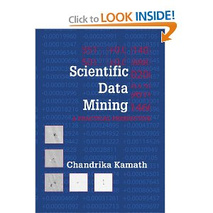
A large part of this course was extracted from these excellent books:
Introduction to Data Mining
Pang-Ning Tan, Michael Steinbach, Vipin Kumar, University of Minnesota
Scientific Data Mining
C. Kamath, SIAM publisher 2009

Slide 3
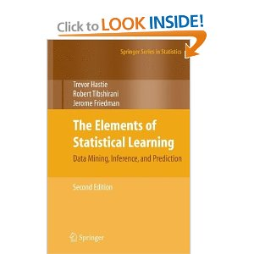
The Elements of Statistical Learning: Data Mining, Inference, and Prediction, Second Edition (Springer Series in Statistics) by Trevor Hastie, Robert Tibshirani and Jerome Friedman (2009) , Springer

Slide 4
Five slides on what is Data Mining. I
Data mining (the analysis step of the Knowledge Discovery in Databases process, or KDD), a relatively young and interdisciplinary field of computer science, is the process of extracting patterns from large data sets by combining methods from statistics and artificial intelligence with database management ….
With recent technical advances in processing power, storage capacity, and inter-connectivity of computer technology, data mining is an increasingly important tool by modern business to transform unprecedented quantities of digital data into business intelligence giving an informational advantage.
The growing consensus that data mining can bring real value has led to an explosion in demand for novel data mining technologies….
From Wikipedia

Slide 5
… Excusatio non petita, accusatio manifesta …
There is a lot of confusion which can discourage people.
Initially part of KDD (Knowledge Discovery in Databases) together with data preparation, data presentation and data interpretation, DM has encountered a lot of difficulties in defining precise boundaries…
In 1999 the NASA panel on the application of data mining to scientific problems concluded that: “it was difficult to arrive at a consensus for the definition of data mining… apart from the clear importance of scalability as an underlying issue”.
people who work in machine learning, pattern recognition or exploratory data analysis, often (and erroneously) view it as an extension of what they have been doing for many years…

Slide 6
DM inherited some bad reputation from initial applications.
Data Mining and Data dredging (data fishing, data snooping, etc…) were used to sample parts of a larger population data set that were too small for reliable statistical inferences to be made about the validity of any patterns
For instance, till few years ago, statisticians considered DM methods as an unacceptable oversimplification
    People also wrongly believe that DM methods are a sort of black box completely out of control…

Slide 7
DATA MINING: my definition
Data Mining is the process concerned with automatically uncovering patterns, associations, anomalies, and statistically significant structures in large and/or complex data sets
Therefore it includes all those disciplines which can be used to uncover useful information in the data
What is new is the confluence of the most mature offshoots of many disciplines with technological advances
As such, its contents are «user defined» and more than a new discipline it is an ensemble of different methodologies originated in different fields

Slide 8

D. Rumsfeld on DM functionalities…
There are known knowns,
There are known unknowns,
and
There are unknown unknowns
Classification
Morphological classification of galaxies
Star/galaxy separation, etc.
Regression
Photometric redshifts
Donald Rumsfeld’s
about Iraqi war
Clustering
Search for peculiar and rare objects,
Etc.
Courtesy of S.G. Djorgovski

Slide 9
Is Data Mining useful?
Can it ensure the accuracy required by scientific applications?
    Finding the optimal route for planes, Stock market, Genomics, Tele-medicine and remote diagnosis, environmental risk assessment, etc… HENCE…. Very likely yes
Is it an easy task to be used in everyday applications (small data sets, routine work, etc.)?
    NO!!
Can it work without a deep knowledge of the data models and of the DM algorithms/models?
    NO!!
Can we do without it?
On large and complex data sets (TB-PB domain), NO!!!

Slide 10
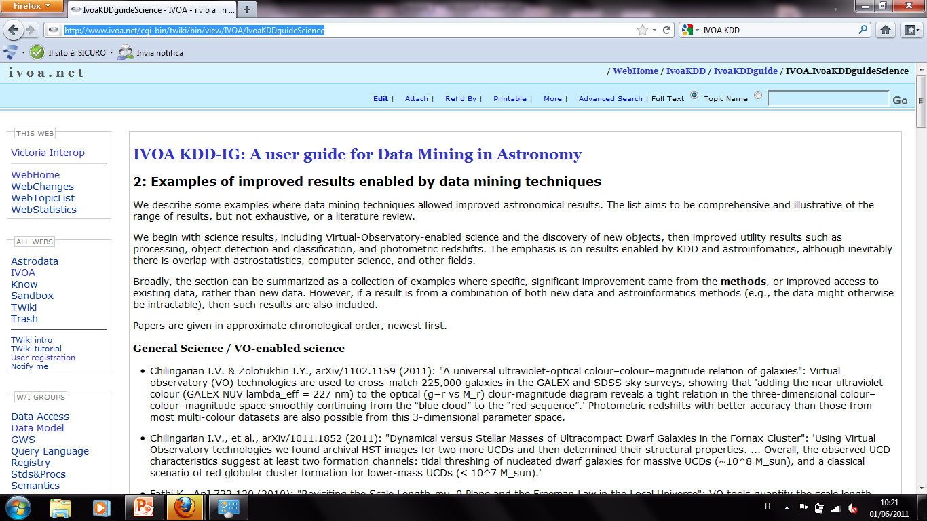
http://www.ivoa.net/cgi-bin/twiki/bin/view/IVOA/IvoaKDDguideScience
Prepared and Mantained by N. Ball at the IVOA – IG-KDD pages

Slide 11
Scalability of some algorithms relevant to astronomy
• Querying: spherical range-search O(N), orthogonal range-search O(N), spatial join O(N²), nearest-neighbor O(N), all-nearest-neighbors O(N²)
• Density estimation: mixture of Gaussians, kernel density estimation O(N²), kernel conditional density estimation O(N³)
• Regression: linear regression, kernel regression O(N²), Gaussian process regression O(N³)
• Classification: decision tree, nearest-neighbor classifier O(N²), nonparametric Bayes classifier O(N²), support vector machine O(N³)
• Dimension reduction: principal component analysis, non-negative matrix factorization, kernel PCA O(N³), maximum variance unfolding O(N³)
• Outlier detection: by density estimation or dimension reduction O(N³)
• Clustering: by density estimation or dimension reduction, k-means, meanshift segmentation O(N²), hierarchical (FoF) clustering O(N³)
• Time series analysis: Kalman filter, hidden Markov model, trajectory tracking O(N^{n})
• Feature selection and causality: LASSO, L1 SVM, Gaussian graphical models, discrete graphical models
• 2-sample testing and testing and matching: bipartite matching O(N³), n-point correlation O(N^{n})
Courtesy of A. Gray – Astroinformatics 2010

Slide 12
Other relevant parameters
N = no. of data vectors,
D = no. of data dimensions
K = no. of clusters chosen,
K_{max} = max no. of clusters tried
I = no. of iterations,
M = no. of Monte Carlo trials/partitions
K-means: K × N × I × D
Expectation Maximisation: K × N × I × D²
Monte Carlo Cross-Validation: M × K_{max}² × N × I × D²
Correlations ~ N log N or N², ~ D^{k} (k ≥ 1)
Likelihood, Bayesian ~ N^{m} (m ≥ 3), ~ D^{k} (k ≥ 1)
SVM > ~ (NxD)³

Slide 13
HPC
Data Visualization
Mathematical Optimization
DATA MINING
Machine
Learning
Statistics & Statistical
Pattern Recognition
Image Understanding

Slide 14

Use cases and domain knowledge….
… define workflows of functionalities
Dim. reduction
Regression
Clustering
Classification
… which are implemented by specific models and algorithms
Neural Networks (MLPs, MLP-GA, RBF, etc.)
Support Vector Machines
&SVM-C
Decision trees
K-D trees
PPS
Genetic algorithms
Bayesian networks
Etc…
Modes
supervised
Unsupervised
hybrid

Slide 15
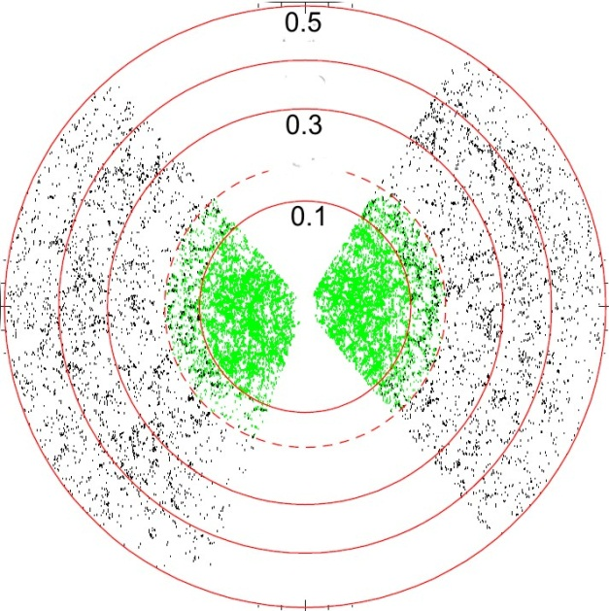
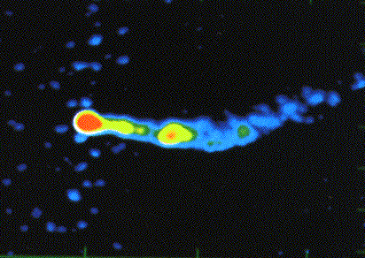
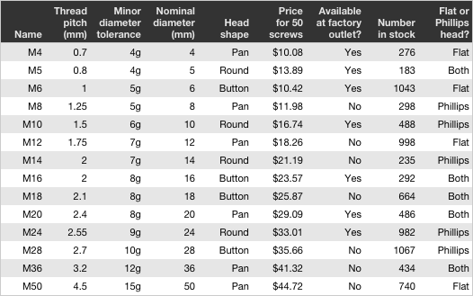

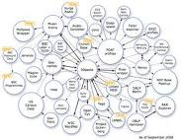
STARTING POINT:
THE DATA

Slide 16
Some considerations on the Data
Data set: collection of data objects and their attributes
  Data Object: a collection of objects. Also known as record, point, case, sample, entity, or instance
Attributes: a property or a characteristic of the objects. Also called: variables, feature, field, characteristic
Attribute values:are numbers or symbols assigned to an attribute
The same attribute can be mapped to different attribute values
Magnitudes or fluxes

Slide 17
DATA SET: HCG90
ID | RA | DEC | z | B | Etc.
NGC7172 | 22h02m01.9s | -31d52m11s | 0.008683 | 12.85 | …
NGC7173 | 22h02m03.2s | -31d58m25s | 0.008329 | 13.08 | …
NGC7174 | 22h02m06.4s | -31d59m35s | 0.008869 | 14.23 | …
NGC7176 | 22h02m08.4s | -31d59m23s | 0.008376 | 12.34
objects
attributes

Slide 18

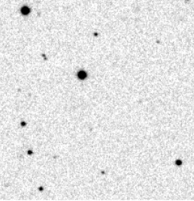


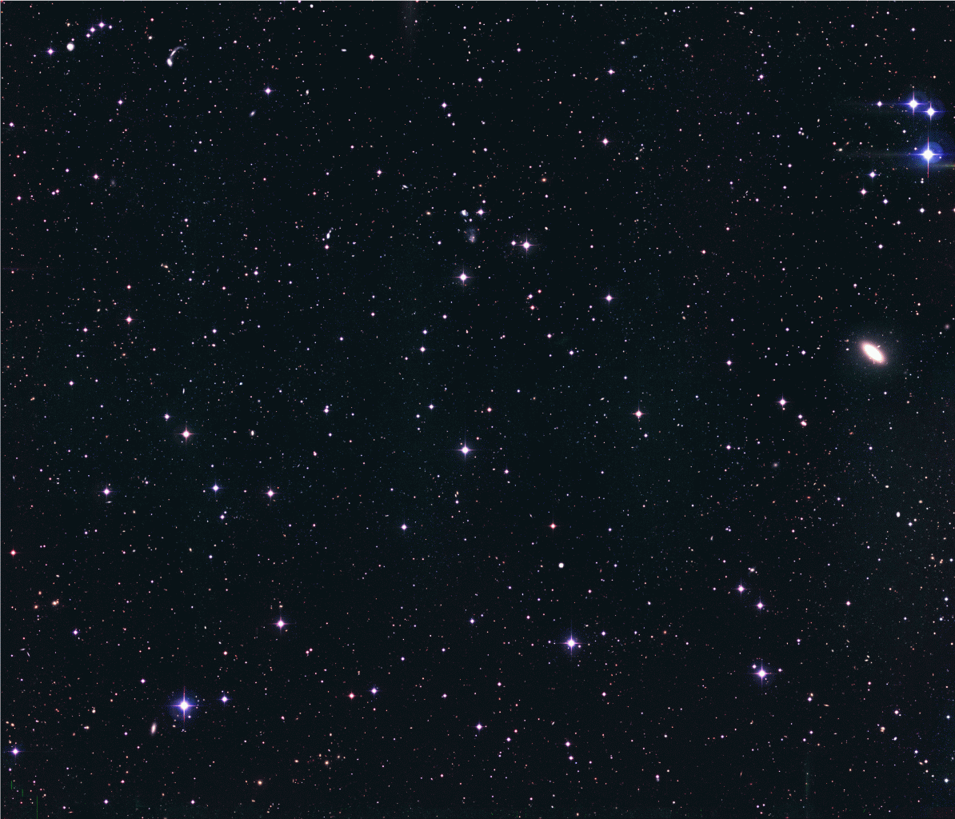
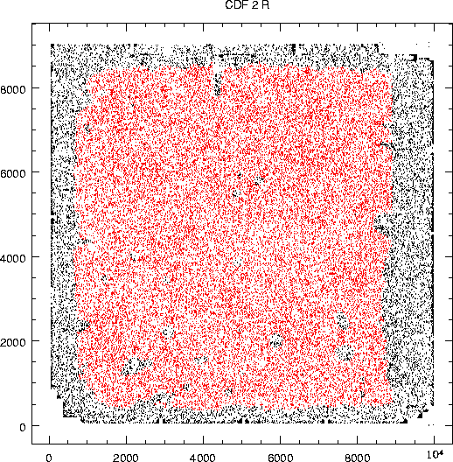
The universe is densely packed
Band 1
Band 2
Calibrated data
1/160.000 of the sky, moderately deep (25.0 in r)
55.000 detected sources
(0.75 mag above m lim)
30 arcmin
Band 3
…..
Band n

Slide 19

The exploding parameter space…
p={isophotal, petrosian, aperture magnitudes
concentration indexes, shape parameters, etc.}
The scientific exploitation of a multi band, multiepoch (K epochs) universe implies to search for patterns, trends, etc. among N points in a DxK dimensional parameter space:
N >10⁹, D>>100, K>10

Slide 20

The parameter space
Vesuvius, now
Any observed (simulated) datum p defines a point (region) in a subset of R^{N.} Es:
RA and dec
time
λ
experimental setup (spatial and spectral resolution, limiting mag, limiting surface brightness, etc.) parameters
fluxes
polarization
Etc.
R.A
δ
t
The parameter space concept is crucial to:
Guide the quest for new discoveries
(observations can be guided to explore poorly known regions), …
Find new physical laws (patterns)
Etc,
Lim s.b.
λ
Etc.
polarization
Lim. Mag.
spect. resol
time resol.
Spatial resol.

Slide 21
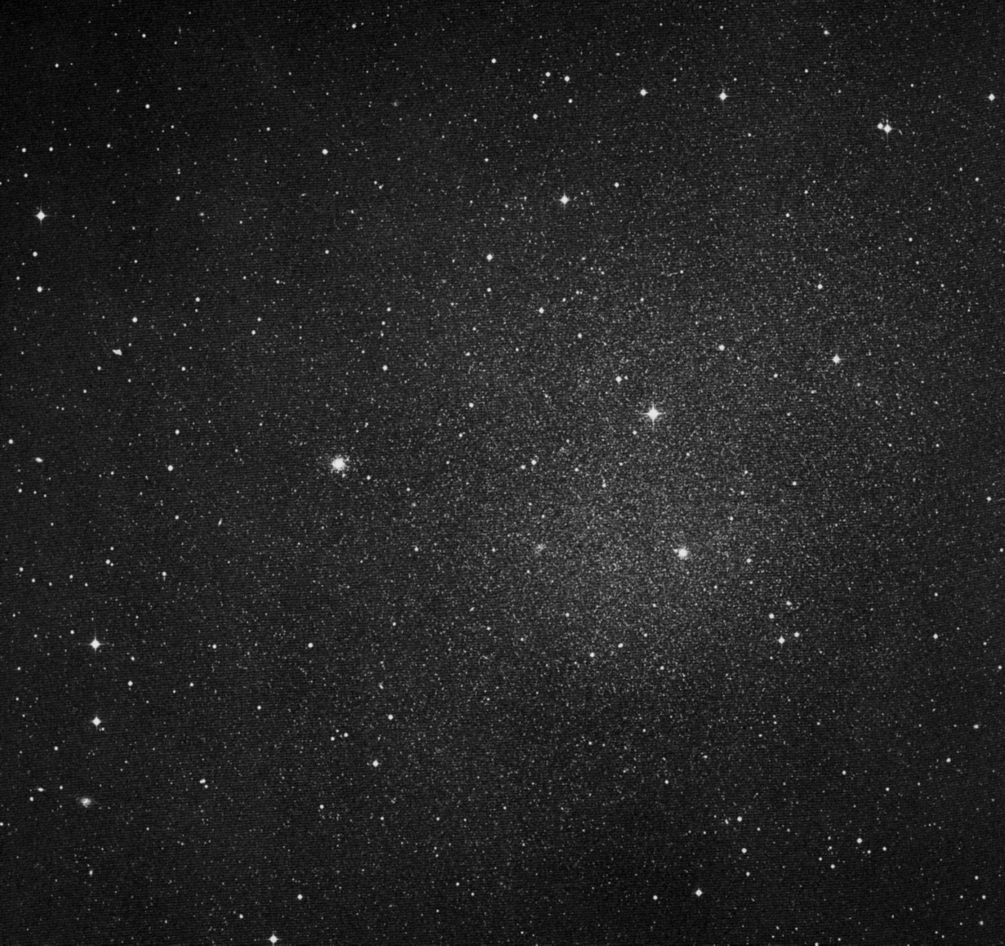
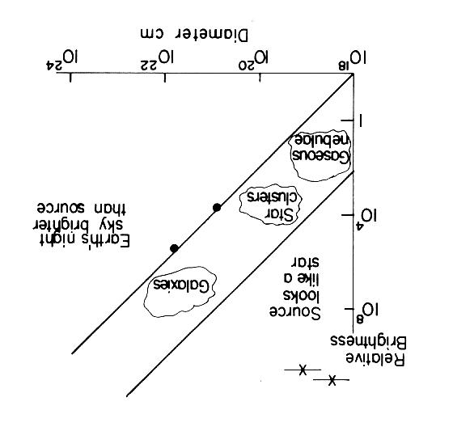
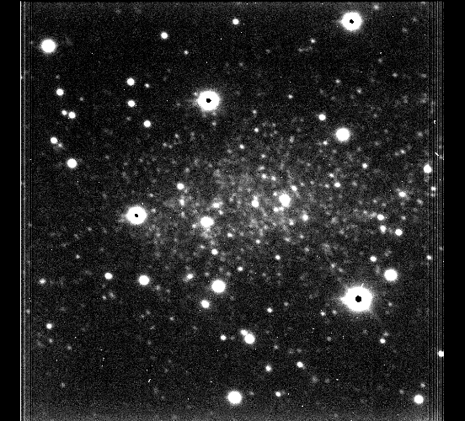
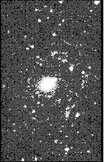
Every time you improve the coverage of the PS….
Every time a new technology enlarges the parameter space or allows a better sampling of it, new discoveries are bound to take place
quasars
Fornax dwarf
LSB
Sagittarius
1970’s
1990’s
Discovery of
Low surface brightness
Universe
Malin 1

Slide 22
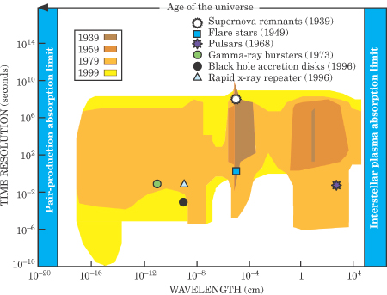
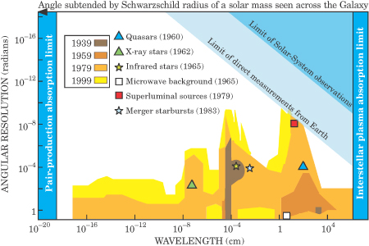
Improving coverage of the Parameter space - II
Projection of parameter space along
(time resolution & wavelength)
Projection of parameter space along
(angular resolution & wavelength)

Slide 23
Types of Attributes
Attribute Type
Description
Examples
Operations
Nominal
The values of a nominal attribute are just different names, i.e., nominal attributes provide only enough information to distinguish one object from another. (=, ≠)
NGC number, SDSS ID numbers, spectral type, etc.)
mode, entropy, contingency correlation, χ² test
Ordinal
The values of an ordinal attribute provide enough information to order objects. (<, >)
Morphological classification, spectral classification ??
median, percentiles, rank correlation, run tests, sign tests
Interval
For interval attributes, the differences between values are meaningful, i.e., a unit of measurement exists.
(+, - )
calendar dates, temperature in Celsius or Fahrenheit
mean, standard deviation, Pearson's correlation, t and F tests
Ratio
For ratio variables, both differences and ratios are meaningful. (*, /)
temperature in Kelvin, monetary quantities, counts, age, mass, length, electrical current
geometric mean, harmonic mean, percent variation

Slide 24
Attribute Level
Transformation
Comments
Nominal
Any permutation of values
If all NGC numbers were reassigned, would it make any difference?
Ordinal
An order preserving change of values, i.e.,
new_value = f(old_value)
where f is a monotonic function.
An attribute encompassing the notion of good, better best can be represented equally well by the values {1, 2, 3} or by { 0.5, 1, 10}.
Interval
new_value =a * old_value + b where a and b are constants
Thus, the Fahrenheit and Celsius temperature scales differ in terms of where their zero value is and the size of a unit (degree).
Ratio
new_value = a * old_value
Length can be measured in meters or feet.

Slide 25
Discrete and Continuous Attributes
Discrete Attribute
  Has only a finite or countably infinite set of values
  Examples: SDSS IDs, zip codes, counts, or the set of words in a collection of documents
  Often represented as integer variables.
  Note: binary attributes (flags) are a special case of discrete attributes
Continuous Attribute
  Has real numbers as attribute values
  Examples: fluxes,
  Practically, real values can only be measured and represented using a finite number of digits.
  Continuous attributes are typically represented as floating-point variables.

Slide 26
LAST TYPE: Ordered Data
Data where the position in a sequence matters:
Es. Genomic sequences
Es. Metereological data
Es. Light curves

Slide 27
Ordered Data
Genomic sequence data

Slide 28
Data Quality
What kinds of data quality problems?
How can we detect problems with the data?
What can we do about these problems?
Examples of data quality problems:
  Noise and outliers
  duplicate data
  missing values

Slide 29
Missing Values
Reasons for missing values
  Information is not collected
  (e.g., instrument/pipeline failure)
  Attributes may not be applicable to all cases
  (e.g. no HI profile in E type galaxies)
Handling missing values
  Eliminate Data Objects
  Estimate Missing Values (for instance upper limits)
  Ignore the Missing Value During Analysis (if method allows it)
  Replace with all possible values (weighted by their probabilities)

Slide 30
Data Preprocessing
Aggregation
Sampling
Dimensionality Reduction
Feature subset selection
Feature creation
Discretization and Binarization
Attribute Transformation

Slide 31
Aggregation
Combining two or more attributes (or objects) into a single attribute (or object)
Purpose
  Data reduction
    Reduce the number of attributes or objects
  Change of scale
    Cities aggregated into regions, states, countries, etc
  More “stable” data
    Aggregated data tends to have less variability

Slide 32
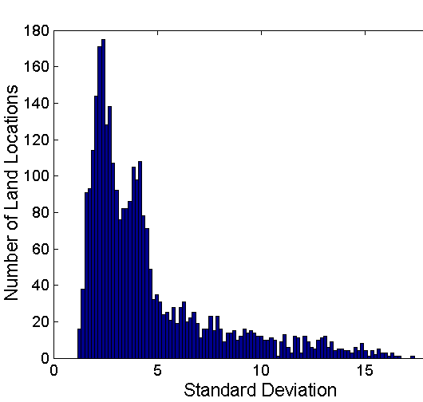
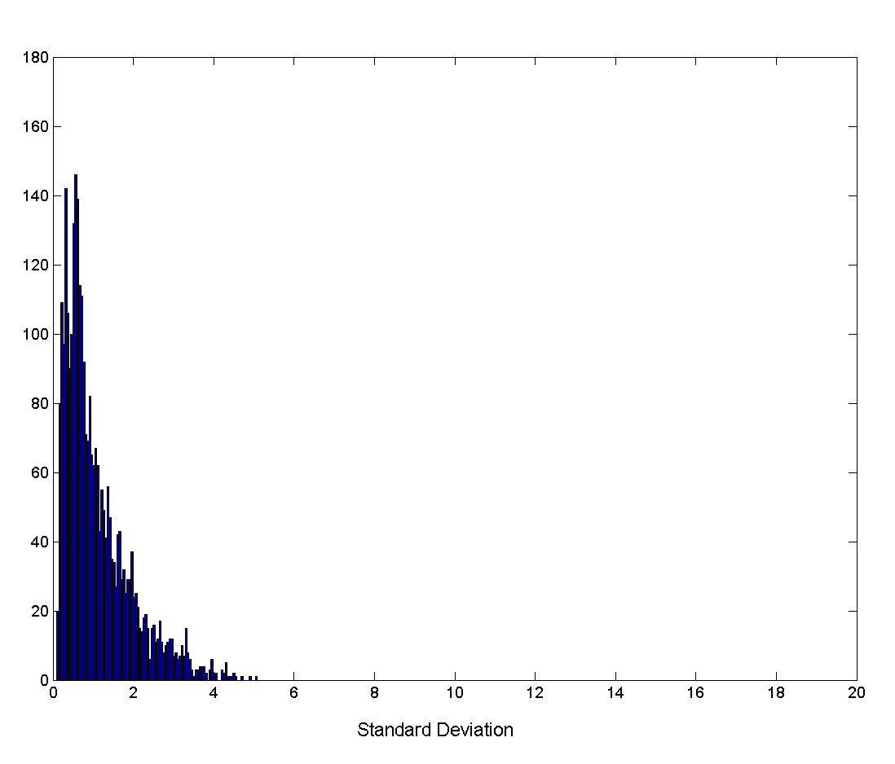
Aggregation
Variation of Precipitation in Australia
Standard Deviation of Average Monthly Precipitation
Standard Deviation of Average Yearly Precipitation

Slide 33
Sampling
Sampling is the main technique employed for data selection.
  It is often used for both the preliminary investigation of the data and the final data analysis.
Statisticians sample because obtaining the entire set of data of interest is too expensive or time consuming.
Sampling is used in data mining because processing the entire set of data of interest is too expensive or time consuming.

Slide 34
Sampling …
The key principle for effective sampling is the following:
  using a sample will work almost as well as using the entire data sets, if the sample is representative
  (remember this when we shall talk about phot-z’s)
  A sample is representative if it has approximately the same property (of interest) as the original set of data
  (sometimes this may be verified only a posteriori)

Slide 35
Types of Sampling
Simple Random Sampling
  There is an equal probability of selecting any particular item
Sampling without replacement
  As each item is selected, it is removed from the population
Sampling with replacement
  Objects are not removed from the population as they are selected for the sample.
    In sampling with replacement, the same object can be picked up more than once
Stratified sampling
  Split the data into several partitions; then draw random samples from each partition

Slide 36

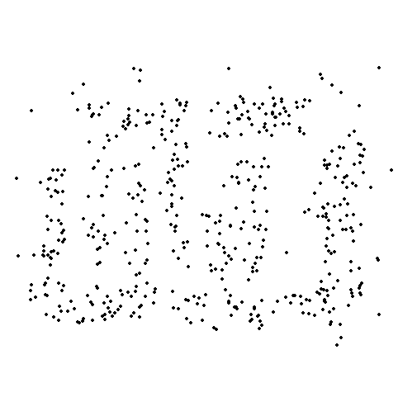
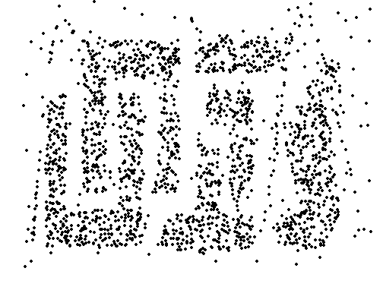
Sample Size matters
8000 points 2000 Points 500 Points

Slide 37
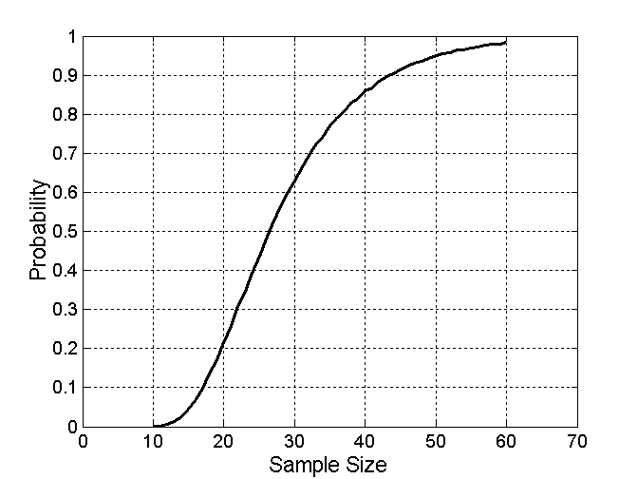

Sample Size
What sample size is necessary to get at least one object from each of 10 groups.

Slide 38

3-D is always better than 2-D
N-D is not always better than (N-1)-D

Slide 39
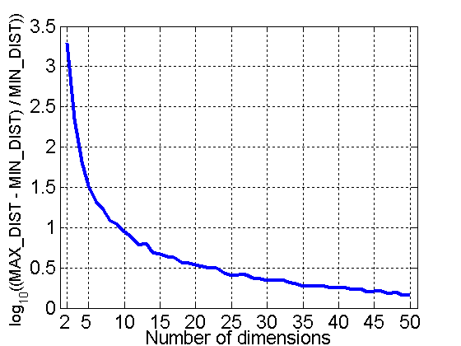
Curse of Dimensionality (part – II)
When dimensionality increases (es. Adding more parameters), data becomes increasingly sparse in the space that it occupies
Definitions of density and distance between points, which is critical for clustering and outlier detection, become less meaningful
Randomly generate 500 points
Compute difference between max and min distance between any pair of points

Slide 40
Dimensionality Reduction
Purpose:
  Avoid curse of dimensionality
  Reduce amount of time and memory required by data mining algorithms
  Allow data to be more easily visualized
  May help to eliminate irrelevant features or reduce noise
Some Common Techniques
  Principle Component Analysis
  Singular Value Decomposition
  Others: supervised and non-linear techniques

Slide 41
Feature Subset Selection
First way to reduce the dimensionality of data
Redundant features
  duplicate much or all of the information contained in one or more other attributes
  Example: 3 magnitudes and 2 colors can be represented as 1 magnitude and 2 colors
Irrelevant features
  contain no information that is useful for the data mining task at hand … Example: ID is irrelevant to the task of deriving photometric redshifts
Exploratory Data Analysis is crucial.
Refer to the book by Kumar et al.

Slide 42
Dimensionality Reduction: PCA
Find the eigenvectors of the covariance matrix
The eigenvectors define the new space of lower dimensionality
Project the data onto this new space
x₂
e
x₁

Slide 43
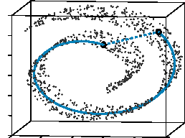
Dimensionality Reduction: ISOMAP
By: Tenenbaum, de Silva, Langford (2000)
Construct a neighbourhood graph
For each pair of points in the graph, compute the shortest path distances – geodesic distances

Slide 44
Feature Subset Selection
Techniques:
  Brute-force approch:
    Try all possible feature subsets as input to data mining algorithm (backwards elimination strategy)
  Embedded approaches:
    Feature selection occurs naturally as part of the data mining algorithm (E.G. SOM)
  Filter approaches:
    Features are selected before data mining algorithm is run

Slide 45
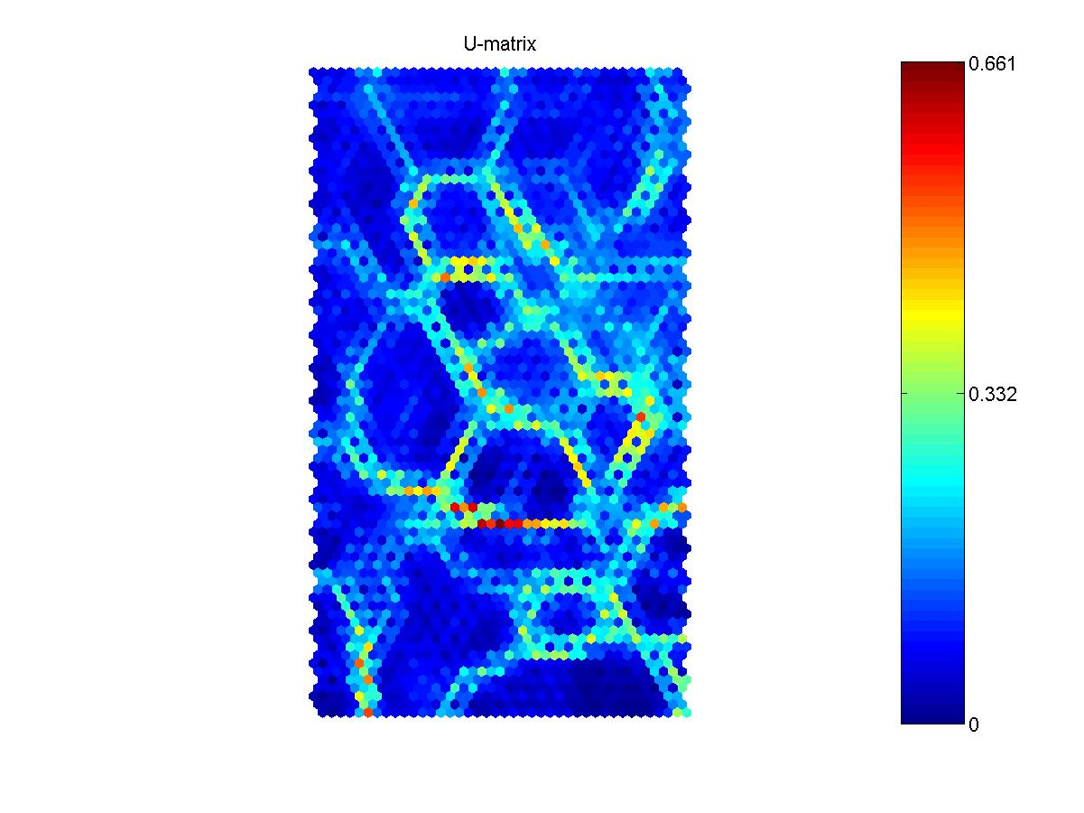
SOM: U-Matrix
SOME DM methods have built in capabilities to operate feature selection
Regions of low values (blue color) represent clusters themselves
Regions of high values (red color) represent cluster borders

Slide 46
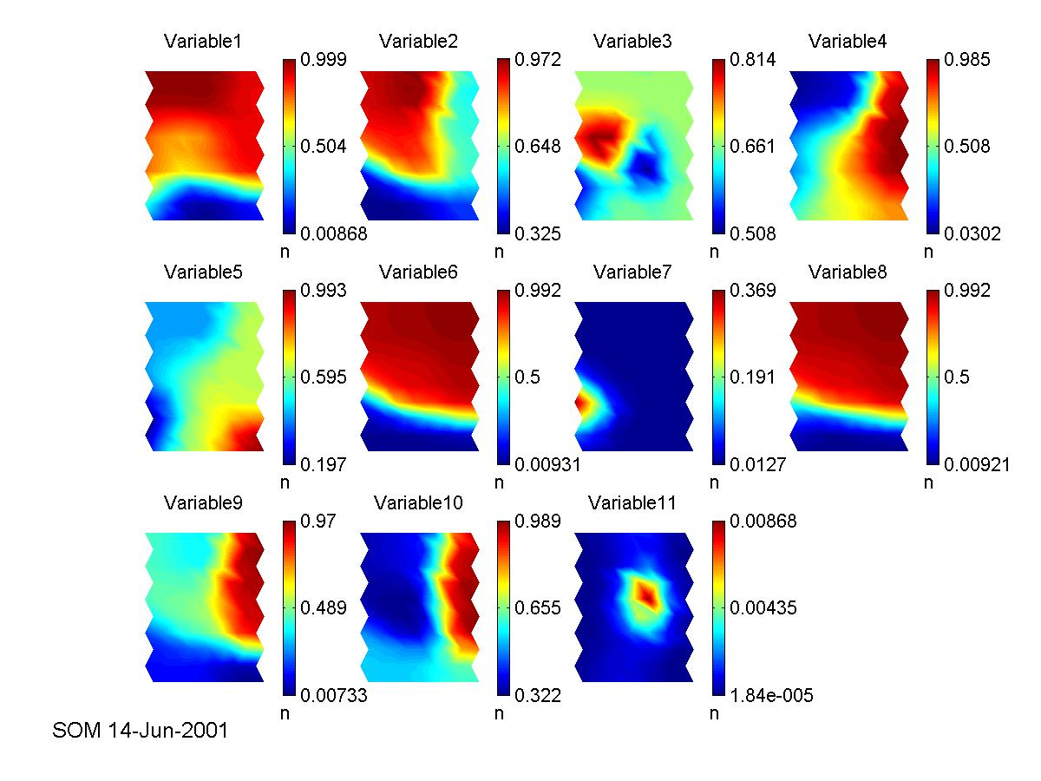

Slide 47
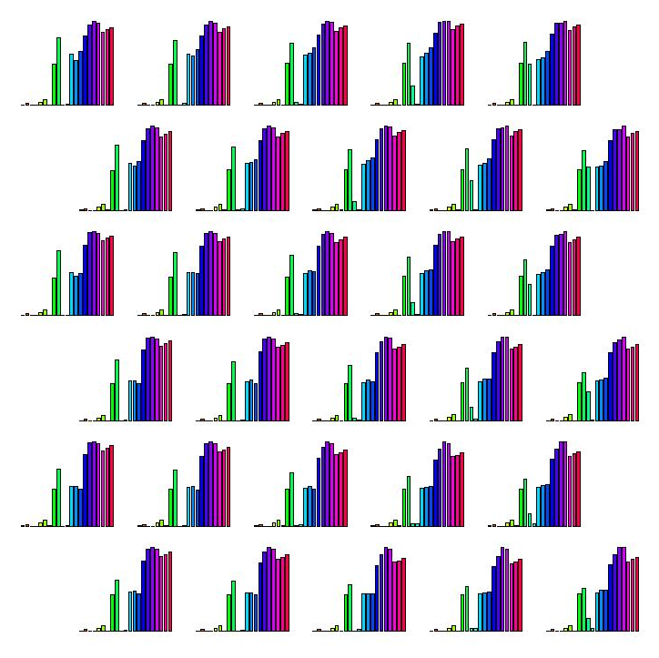
… bar charts

Slide 48
Feature Creation
Create new attributes that can capture the important information in a data set much more efficiently than the original attributes
Three general methodologies:
  Feature Extraction
    domain-specific
  Mapping Data to New Space
  Feature Construction
    combining features

Slide 49
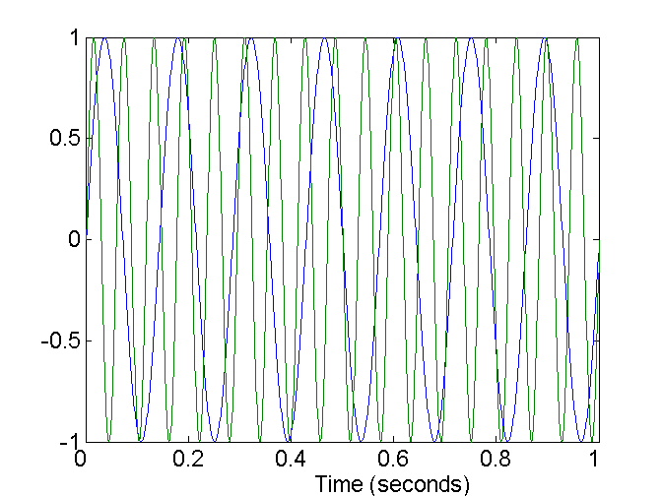
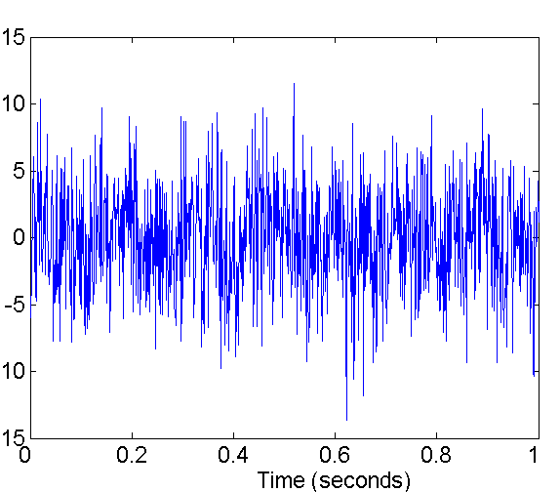
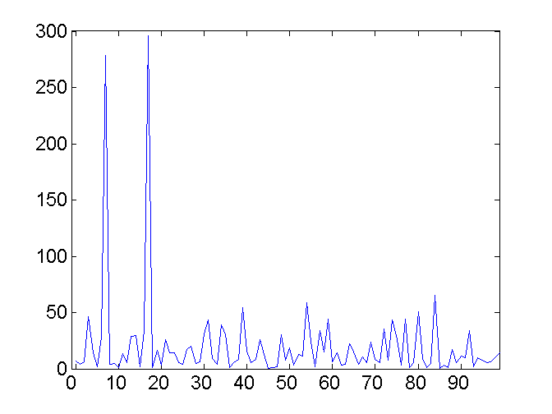
Mapping Data to a New Space
Fourier transform
Wavelet transform
Two Sine Waves
Two Sine Waves + Noise
Frequency

Slide 50
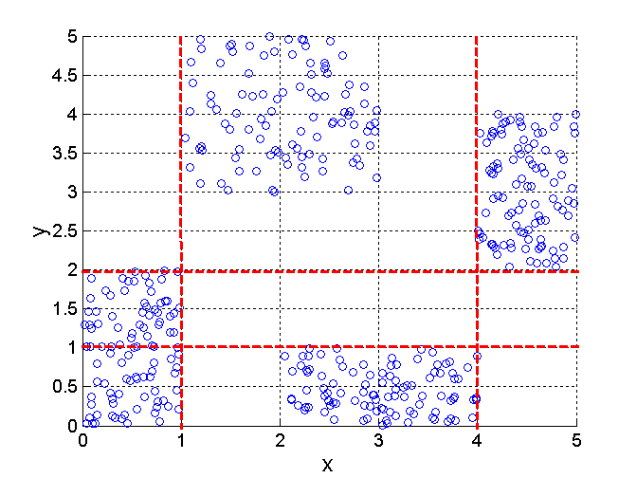
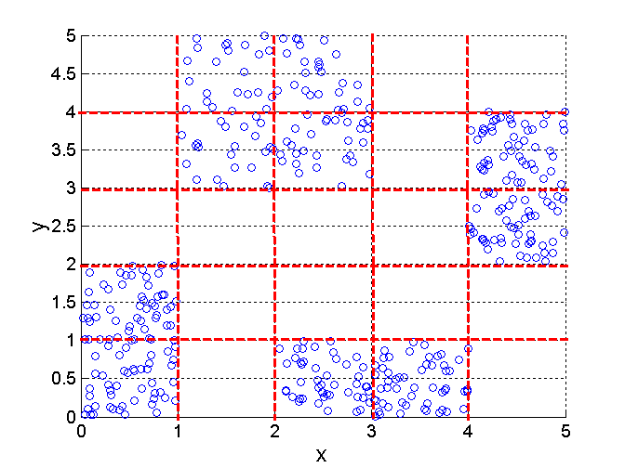
Discretization Using Class Labels
Entropy based approach (see later in clustering)
3 categories for both x and y
5 categories for both x and y

Slide 51
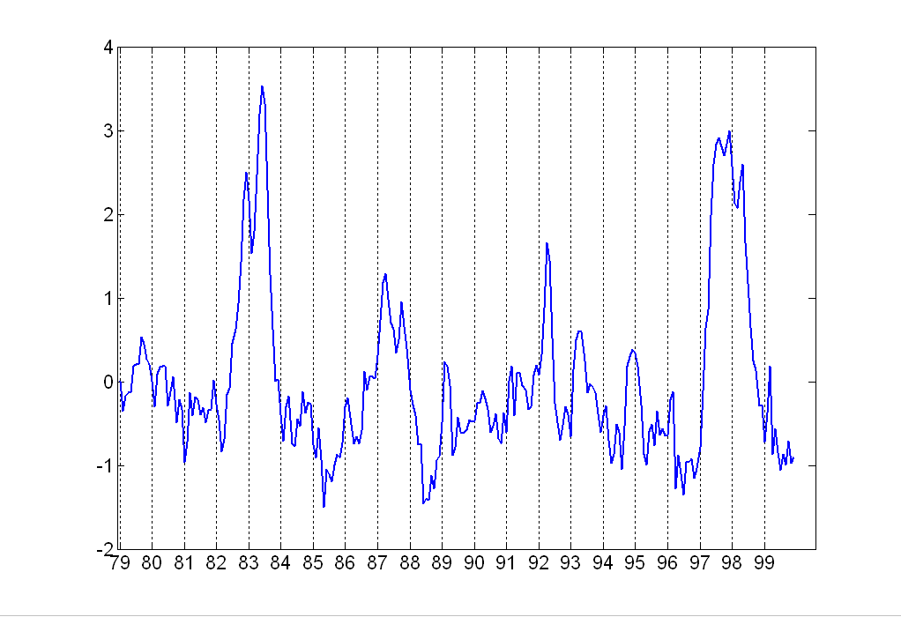
Attribute Transformation
A function that maps the entire set of values of a given attribute to a new set of replacement values such that each old value can be identified with one of the new values
  Simple functions: x^{k}, log(x), e^{x}, |x|
  Standardization and Normalization

Slide 52
Similarity and Dissimilarity
Similarity
  Numerical measure of how alike two data objects are.
  Is higher when objects are more alike.
  Often falls in the range [0,1]
Dissimilarity
  Numerical measure of how different are two data objects
  Lower when objects are more alike
  Minimum dissimilarity is often 0
  Upper limit varies
Proximity refers to a similarity or dissimilarity

Slide 53
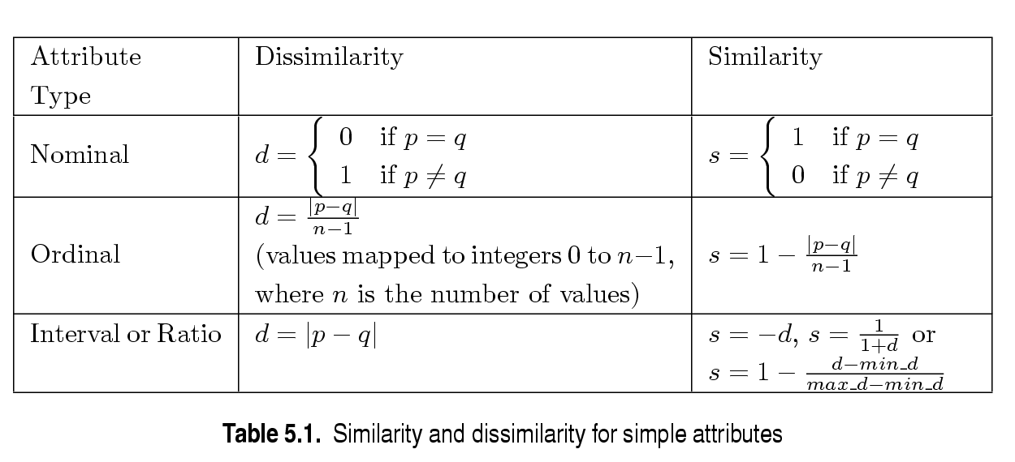
Similarity/Dissimilarity for Simple Attributes
p and q are the attribute values for two data objects.

Slide 54
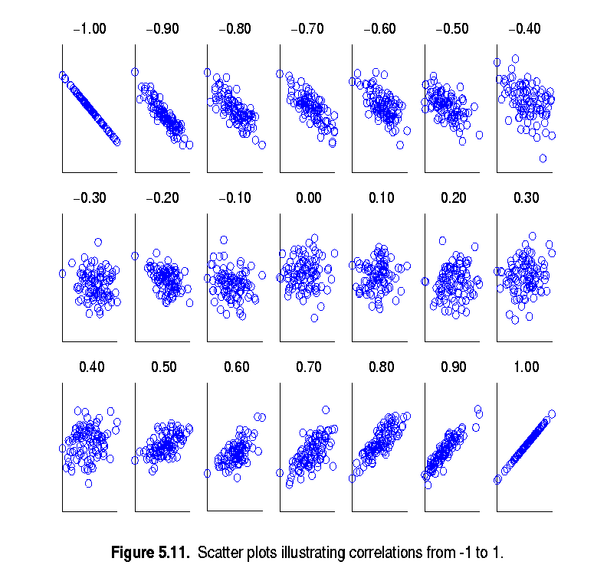
Visually Evaluating Correlation
Scatter plots showing the similarity from –1 to 1.

Slide 55
Euclidean Distance
Euclidean Distance
  Where n is the number of dimensions (attributes) and p_{k} and q_{k} are, respectively, the k^{th} attributes (components) or data objects p and q.
Standardization is necessary, if scales differ.

Slide 56
Euclidean Distance
Distance Matrix

Slide 57
Minkowski Distance
Minkowski Distance is a generalization of Euclidean Distance
  Where r is a parameter, n is the number of dimensions (attributes) and p_{k} and q_{k} are, respectively, the kth attributes (components) or data objects p and q.

Slide 58
Minkowski Distance: Examples
r = 1. City block (Manhattan, taxicab, L₁ norm) distance.
  A common example of this is the Hamming distance, which is just the number of bits that are different between two binary vectors
r = 2. Euclidean distance
r → ∞. “supremum” (L_{max} norm, L∞ norm) distance.
  This is the maximum difference between any component of the vectors
Do not confuse r with n, i.e., all these distances are defined for all numbers of dimensions.

Slide 59
Minkowski Distance
Distance Matrix

Slide 60
The drawback is that we assumed that the sample points are distributed isotropically
Were the distribution non-spherical, for instance ellipsoidal, then the probability of the test point belonging to the set depends not only on the distance from the center of mass, but also on the direction.
Putting this on a mathematical basis, in the case of an ellipsoid, the one that best represents the set's probability distribution can be estimated by building the covariance matrix of the samples.
The Mahalanobis distance is simply the distance of the test point from the center of mass divided by the width of the ellipsoid in the direction of the test point.

Slide 61

Consider the problem of estimating the probability that a test point in N-dimensional Euclidean space belongs to a set, where we are given sample points that definitely belong to that set.
find the average or center of mass of the sample points: the closer the point is to the center of mass, the more likely it is to belong to the set.
However, we also need to know if the set is spread out over a large range or a small range, so that we can decide whether a given distance from the center is noteworthy or not.
The simplistic approach is to estimate the standard deviation of the distances of the sample points from the center of mass.
quantitatively by defining the normalized distance between the test point and the set to be
and plugging this into the normal distribution we can derive the probability of the test point belonging to the set.

Slide 62

Formally, the Mahalanobis distance of a multivariate vector
from a group of values with mean
and covariance matrix S , is defined as:
Mahalanobis distance (or "generalized squared interpoint distance" for its squared value) can also be defined as a dissimilarity measure between two random vectors x and y and of the same distribution with the covariance matrix S :
If the covariance matrix is the identity matrix, the Mahalanobis distance reduces to the Euclidean distance. If the covariance matrix is diagonal, then the resulting distance measure is called the normalized Euclidean distance:
where σ_{i} is the standard deviation of the x_{i} over the sample set..

Slide 63
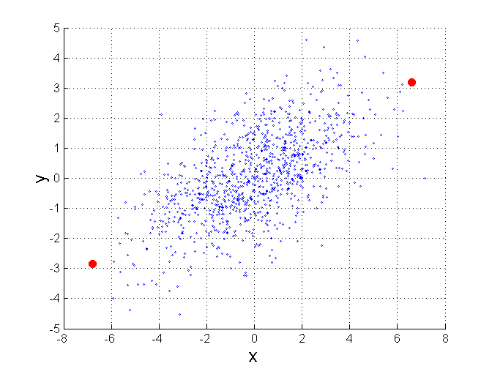
Mahalanobis Distance
Σ is the covariance matrix of the input data X
For red points, the Euclidean distance is 14.7, Mahalanobis distance is 6.

Slide 64
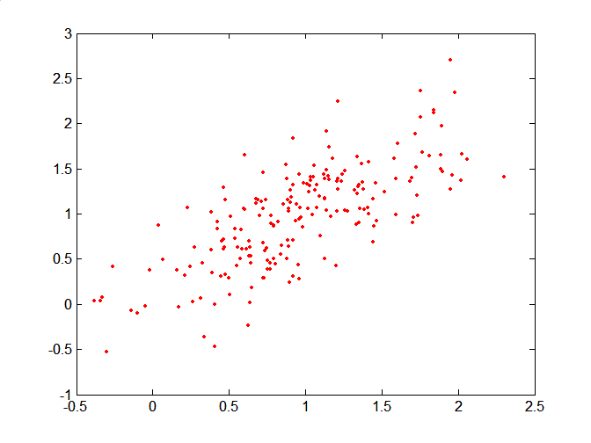
Mahalanobis Distance
Covariance Matrix:
C
B
A: (0.5, 0.5)
B: (0, 1)
C: (1.5, 1.5)
Mahal(A,B) = 5
Mahal(A,C) = 4
A

Slide 65
Common Properties of a Distance
Distances, such as the Euclidean distance, have some well known properties.
  d(p, q) ≥ 0 for all p and q and d(p, q) = 0 only if
  p = q. (Positive definiteness)
  d(p, q) = d(q, p) for all p and q. (Symmetry)
  d(p, r) ≤ d(p, q) + d(q, r) for all points p, q, and r.
  (Triangle Inequality)
where d(p, q) is the distance (dissimilarity) between points (data objects), p and q.
A distance that satisfies these properties is a metric

Slide 66
Common Properties of a Similarity
Similarities, also have some well known properties.
  s(p, q) = 1 (or maximum similarity) only if p = q.
  s(p, q) = s(q, p) for all p and q. (Symmetry)
where s(p, q) is the similarity between points (data objects), p and q.

Slide 67
Similarity Between Binary Vectors
Common situation is that objects, p and q, have only binary attributes
Compute similarities using the following quantities
M₀₁ = the number of attributes where p was 0 and q was 1
M₁₀ = the number of attributes where p was 1 and q was 0
M₀₀ = the number of attributes where p was 0 and q was 0
M₁₁ = the number of attributes where p was 1 and q was 1
Simple Matching and Jaccard Coefficients
SMC = number of matches / number of attributes
= (M₁₁ + M₀₀) / (M₀₁ + M₁₀ + M₁₁ + M₀₀)
J = number of 11 matches / number of not-both-zero attributes values
= (M₁₁) / (M₀₁ + M₁₀ + M₁₁)

Slide 68
Cosine Similarity
If d₁ and d₂ are two document vectors, then
cos( d₁, d₂ ) = (d₁ • d₂) / ||d₁|| ||d₂|| ,
where • indicates vector dot product and || d || is the length of vector d.
Example:
d₁ = 3 2 0 5 0 0 0 2 0 0
d₂ = 1 0 0 0 0 0 0 1 0 2
d₁ • d₂= 3*1 + 2*0 + 0*0 + 5*0 + 0*0 + 0*0 + 0*0 + 2*1 + 0*0 + 0*2 = 5
||d₁|| = (3*3+2*2+0*0+5*5+0*0+0*0+0*0+2*2+0*0+0*0)^{0.5} = (42) ^{0.5} = 6.481
||d₂|| = (1*1+0*0+0*0+0*0+0*0+0*0+0*0+1*1+0*0+2*2) ^{0.5} = (6) ^{0.5} = 2.245
cos( d₁, d₂ ) = .3150

Slide 69
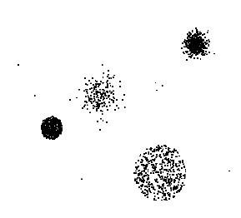
Outliers
Outliers are data objects with characteristics that are considerably different than most of the other data objects in the data set

Slide 70
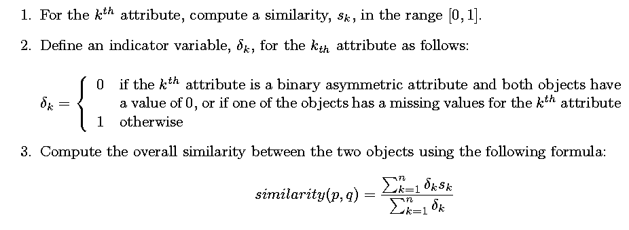
Sometimes attributes are of many different types, but an overall similarity is needed.

Slide 71
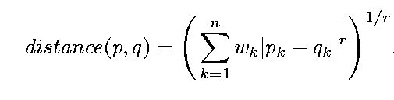

Using Weights to Combine Similarities
May not want to treat all attributes the same.
  Use weights w_{k} which are between 0 and 1 and sum to 1.

Slide 72
Density
Density-based clustering require a notion of density
Examples:
  Euclidean density
    Euclidean density = number of points per unit volume
  Probability density
  Graph-based density

Slide 73
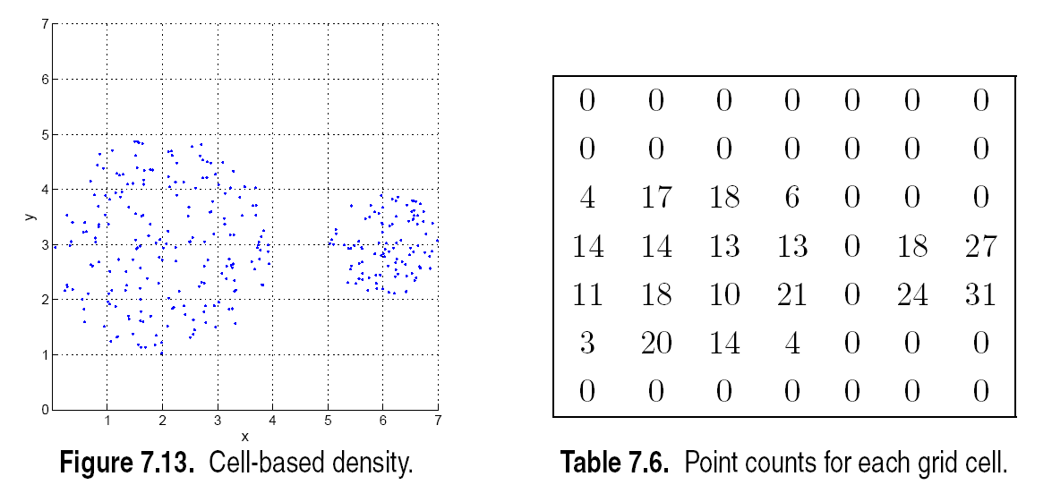
Euclidean Density – Cell-based
Simplest approach is to divide region into a number of rectangular cells of equal volume and define density as # of points the cell contains

Slide 74
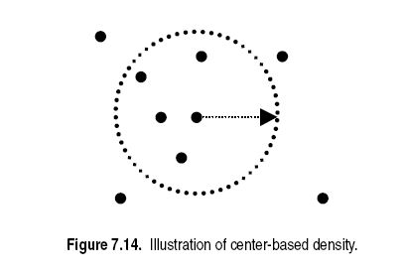
Euclidean Density – Center-based
Euclidean density is the number of points within a specified radius of the point

Slide 75
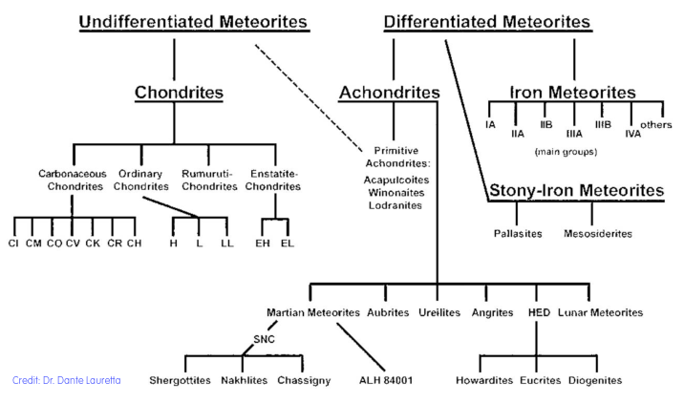
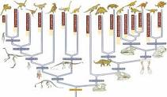
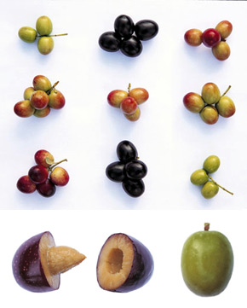
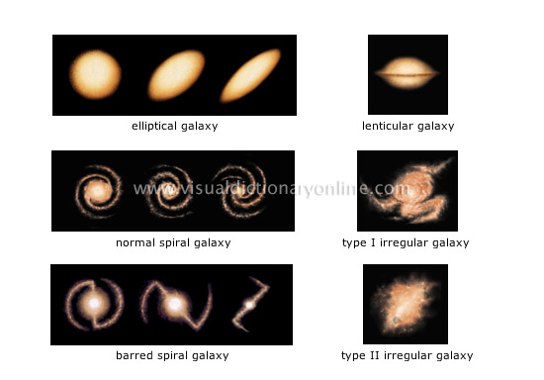
Lecture 3: Classification

Slide 76
Classification: Definition
Given a collection of records (training set )
  Each record contains a set of attributes, one of the attributes is the class.
Find a model for class attribute as a function of the values of other attributes.
Goal: previously unseen records should be assigned a class as accurately as possible.
  A test set is used to determine the accuracy of the model. Usually, the given data set is divided into training and test sets, with training set used to build the model and test set used to validate it.

Slide 77
Illustrating Classification Task

Slide 78

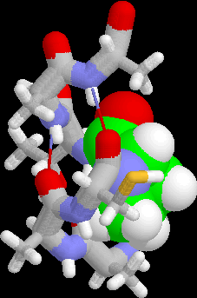
Examples of Classification Task
Predicting tumor cells as benign or malignant
Classifying credit card transactions
as legitimate or fraudulent
Classifying secondary structures of protein
as alpha-helix, beta-sheet, or random
coil
Categorizing news stories as finance,
weather, entertainment, sports, etc

Slide 79
Classification Techniques
Decision Tree based Methods
Rule-based Methods
Memory based reasoning
Neural Networks
Naïve Bayes and Bayesian Belief Networks
Support Vector Machines

Slide 80
Example of a Decision Tree
categorical
categorical
continuous
class
Splitting Attributes
Refund
Yes
No
NO
MarSt
Single, Divorced
Married
TaxInc
NO
< 80K
> 80K
NO
YES
Training Data
Model: Decision Tree

Slide 81
Another Example of Decision Tree
categorical
categorical
continuous
class
MarSt
Single, Divorced
Married
NO
Refund
Yes
No
NO
TaxInc
< 80K
> 80K
NO
YES
There could be more than one tree that fits the same data!

Slide 82
Decision Tree Classification Task
Decision Tree

Slide 83
Apply Model to Test Data
Test Data
Start from the root of tree.
Refund
Yes
No
NO
MarSt
Single, Divorced
Married
TaxInc
NO
< 80K
> 80K
NO
YES

Slide 84
Apply Model to Test Data
Test Data
Refund
Yes
No
NO
MarSt
Single, Divorced
Married
TaxInc
NO
< 80K
> 80K
NO
YES

Slide 85
Apply Model to Test Data
Test Data
Refund
Yes
No
NO
MarSt
Single, Divorced
Married
TaxInc
NO
< 80K
> 80K
NO
YES

Slide 86
Apply Model to Test Data
Test Data
Refund
Yes
No
NO
MarSt
Single, Divorced
Married
TaxInc
NO
< 80K
> 80K
NO
YES

Slide 87
Apply Model to Test Data
Test Data
Refund
Yes
No
NO
MarSt
Single, Divorced
Married
TaxInc
NO
< 80K
> 80K
NO
YES

Slide 88
Apply Model to Test Data
Test Data
Refund
Yes
No
NO
MarSt
Single, Divorced
Married
Assign Cheat to “No”
TaxInc
NO
< 80K
> 80K
NO
YES

Slide 89
Decision Tree Classification Task
Decision Tree

Slide 90
Decision Tree Induction
Many Algorithms:
  Hunt’s Algorithm (one of the earliest)
  CART
  ID3, C4.5
  SLIQ,SPRINT

Slide 91
General Structure of Hunt’s Algorithm
Let D_{t} be the set of training records that reach a node t
General Procedure:
  If D_{t} contains records that belong the same class y_{t}, then t is a leaf node labeled as y_{t}
  If D_{t} is an empty set, then t is a leaf node labeled by the default class, y_{d}
  If D_{t} contains records that belong to more than one class, use an attribute test to split the data into smaller subsets. Recursively apply the procedure to each subset.
D_{t}
?

Slide 92
Hunt’s Algorithm
Refund
Don’t
Cheat
Yes
No
Don’t
Cheat
Don’t
Cheat
Refund
Refund
Yes
No
Yes
No
Don’t
Cheat
Marital
Status
Don’t
Cheat
Marital
Status
Single,
Divorced
Single,
Divorced
Married
Married
Cheat
Don’t
Cheat
Taxable
Income
Don’t
Cheat
< 80K
>= 80K
Don’t
Cheat
Cheat

Slide 93
Tree Induction
Greedy strategy.
  Split the records based on an attribute test that optimizes certain criterion.
Issues
  Determine how to split the records
    How to specify the attribute test condition?
    How to determine the best split?
  Determine when to stop splitting

Slide 94
Tree Induction
Greedy strategy.
  Split the records based on an attribute test that optimizes certain criterion.
Issues
  Determine how to split the records
    How to specify the attribute test condition?
    How to determine the best split?
  Determine when to stop splitting

Slide 95
How to Specify Test Condition?
Depends on attribute types
  Nominal
  Ordinal
  Continuous
Depends on number of ways to split
  2-way split
  Multi-way split

Slide 96
Splitting Based on Nominal Attributes
Multi-way split: Use as many partitions as distinct values.
Binary split: Divides values into two subsets.
Need to find optimal partitioning.
CarType
Family
Luxury
Sports
CarType
CarType
{Sports, Luxury}
OR
{Family,
Luxury}
{Family}
{Sports}

Slide 97
Splitting Based on Ordinal Attributes
Multi-way split: Use as many partitions as distinct values.
Binary split: Divides values into two subsets.
Need to find optimal partitioning.
What about this split?
Size
Small
Large
Medium
Size
Size
{Small, Medium}
OR
{Medium,
Large}
{Large}
{Small}
Size
{Small, Large}
{Medium}

Slide 98
Splitting Based on Continuous Attributes
Different ways of handling
  Discretization to form an ordinal categorical attribute
    Static – discretize once at the beginning
    Dynamic – ranges can be found by equal interval bucketing, equal frequency bucketing
    (percentiles), or clustering.
  Binary Decision: (A < v) or (A ≥ v)
    consider all possible splits and finds the best cut
    can be more compute intensive

Slide 99
Splitting Based on Continuous Attributes

Slide 100
Tree Induction
Greedy strategy.
  Split the records based on an attribute test that optimizes certain criterion.
Issues
  Determine how to split the records
    How to specify the attribute test condition?
    How to determine the best split?
  Determine when to stop splitting

Slide 101
How to determine the Best Split
Before Splitting: 10 records of class 0,
10 records of class 1
Which test condition is the best?

Slide 102
How to determine the Best Split
Greedy approach:
  Nodes with homogeneous class distribution are preferred
Need a measure of node impurity:
Non-homogeneous,
High degree of impurity
Homogeneous,
Low degree of impurity

Slide 103
Measures of Node Impurity
Gini Index
Entropy
Misclassification error

Slide 104
How to Find the Best Split
Before Splitting:
M0
A?
B?
Yes
No
Yes
No
Node N1
Node N2
Node N3
Node N4
M1
M2
M3
M4
M12
M34
Gain = M0 – M12 vs M0 – M34

Slide 105
Measure of Impurity: GINI
Gini Index for a given node t :
    (NOTE: p( j | t) is the relative frequency of class j at node t).
  Maximum (1 - 1/n_{c}) when records are equally distributed among all classes, implying least interesting information
  Minimum (0.0) when all records belong to one class, implying most interesting information

Slide 106
Examples for computing GINI
P(C1) = 0/6 = 0 P(C2) = 6/6 = 1
Gini = 1 – P(C1)² – P(C2)² = 1 – 0 – 1 = 0
P(C1) = 1/6 P(C2) = 5/6
Gini = 1 – (1/6)² – (5/6)² = 0.278
P(C1) = 2/6 P(C2) = 4/6
Gini = 1 – (2/6)² – (4/6)² = 0.444

Slide 107
Splitting Based on GINI
Used in CART, SLIQ, SPRINT.
When a node p is split into k partitions (children), the quality of split is computed as,
where, n_{i} = number of records at child i,
n = number of records at node p.

Slide 108
Binary Attributes: Computing GINI Index
Splits into two partitions
Effect of Weighing partitions:
  Larger and Purer Partitions are sought for.
B?
Yes
No
Node N1
Node N2
Gini(N1)
= 1 – (5/6)² – (2/6)²
= 0.194
Gini(N2)
= 1 – (1/6)² – (4/6)²
= 0.528
Gini(Children)
= 7/12 * 0.194 +
5/12 * 0.528
= 0.333

Slide 109
Categorical Attributes: Computing Gini Index
For each distinct value, gather counts for each class in the dataset
Use the count matrix to make decisions
Multi-way split
Two-way split
(find best partition of values)

Slide 110
Continuous Attributes: Computing Gini Index
Use Binary Decisions based on one value
Several Choices for the splitting value
  Number of possible splitting values
  = Number of distinct values
Each splitting value has a count matrix associated with it
  Class counts in each of the partitions, A < v and A ≥ v
Simple method to choose best v
  For each v, scan the database to gather count matrix and compute its Gini index
  Computationally Inefficient! Repetition of work.

Slide 111
Continuous Attributes: Computing Gini Index...
For efficient computation: for each attribute,
  Sort the attribute on values
  Linearly scan these values, each time updating the count matrix and computing gini index
  Choose the split position that has the least gini index
Sorted Values
Split Positions

Slide 112
Alternative Splitting Criteria based on INFO
Entropy at a given node t:
    (NOTE: p( j | t) is the relative frequency of class j at node t).
  Measures homogeneity of a node.
    Maximum (log n_{c}) when records are equally distributed among all classes implying least information
    Minimum (0.0) when all records belong to one class, implying most information
  Entropy based computations are similar to the GINI index computations

Slide 113
Examples for computing Entropy
P(C1) = 0/6 = 0 P(C2) = 6/6 = 1
Entropy = – 0 log 0 – 1 log 1 = – 0 – 0 = 0
P(C1) = 1/6 P(C2) = 5/6
Entropy = – (1/6) log₂ (1/6) – (5/6) log₂ (1/6) = 0.65
P(C1) = 2/6 P(C2) = 4/6
Entropy = – (2/6) log₂ (2/6) – (4/6) log₂ (4/6) = 0.92

Slide 114
Splitting Based on INFO...
Information Gain:
    Parent Node, p is split into k partitions;
    n_{i} is number of records in partition i
  Measures Reduction in Entropy achieved because of the split. Choose the split that achieves most reduction (maximizes GAIN)
  Used in ID3 and C4.5
  Disadvantage: Tends to prefer splits that result in large number of partitions, each being small but pure.

Slide 115
Splitting Based on INFO...
Gain Ratio:
    Parent Node, p is split into k partitions
    n_{i} is the number of records in partition i
  Adjusts Information Gain by the entropy of the partitioning (SplitINFO). Higher entropy partitioning (large number of small partitions) is penalized!
  Used in C4.5
  Designed to overcome the disadvantage of Information Gain

Slide 116
Splitting Criteria based on Classification Error
Classification error at a node t :
Measures misclassification error made by a node.
    Maximum (1 - 1/n_{c}) when records are equally distributed among all classes, implying least interesting information
    Minimum (0.0) when all records belong to one class, implying most interesting information

Slide 117
Examples for Computing Error
P(C1) = 0/6 = 0 P(C2) = 6/6 = 1
Error = 1 – max (0, 1) = 1 – 1 = 0
P(C1) = 1/6 P(C2) = 5/6
Error = 1 – max (1/6, 5/6) = 1 – 5/6 = 1/6
P(C1) = 2/6 P(C2) = 4/6
Error = 1 – max (2/6, 4/6) = 1 – 4/6 = 1/3

Slide 118
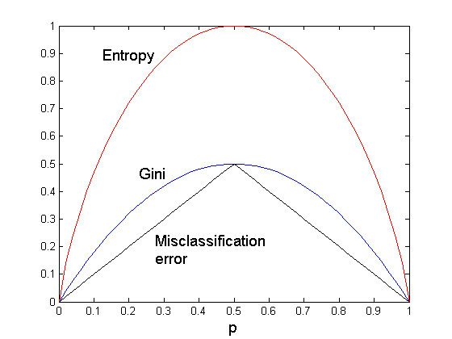
Comparison among Splitting Criteria
For a 2-class problem:

Slide 119
Misclassification Error vs Gini
A?
Yes
No
Node N1
Node N2
Gini(N1)
= 1 – (3/3)² – (0/3)²
= 0
Gini(N2)
= 1 – (4/7)² – (3/7)²
= 0.489
Gini(Children)
= 3/10 * 0
+ 7/10 * 0.489
= 0.342
Gini improves !!

Slide 120
Tree Induction
Greedy strategy.
  Split the records based on an attribute test that optimizes certain criterion.
Issues
  Determine how to split the records
    How to specify the attribute test condition?
    How to determine the best split?
  Determine when to stop splitting

Slide 121
Stopping Criteria for Tree Induction
Stop expanding a node when all the records belong to the same class
Stop expanding a node when all the records have similar attribute values
Early termination (to be discussed later)

Slide 122
Decision Tree Based Classification
Advantages:
  Inexpensive to construct
  Extremely fast at classifying unknown records
  Easy to interpret for small-sized trees
  Accuracy is comparable to other classification techniques for many simple data sets

Slide 123
Example: C4.5
Simple depth-first construction.
Uses Information Gain
Sorts Continuous Attributes at each node.
Needs entire data to fit in memory.
Unsuitable for Large Datasets.
  Needs out-of-core sorting.
You can download the software from:
http://www.cse.unsw.edu.au/~quinlan/c4.5r8.tar.gz

Slide 124
Practical Issues of Classification
Underfitting and Overfitting
Missing Values
Costs of Classification

Slide 125
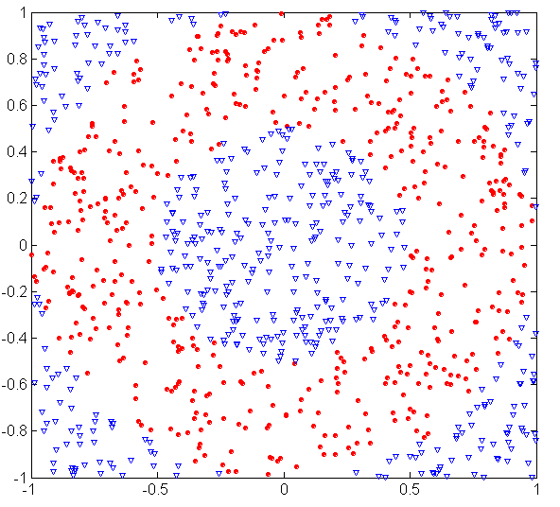
Underfitting and Overfitting (Example)
500 circular and 500 triangular data points.
Circular points:
0.5 ≤ sqrt(x₁²+x₂²) ≤ 1
Triangular points:
sqrt(x₁²+x₂²) > 0.5 or
sqrt(x₁²+x₂²) < 1

Slide 126
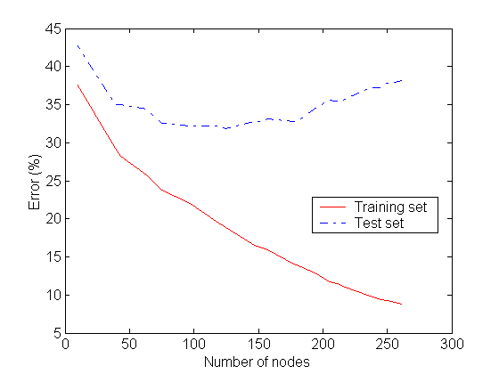
Underfitting and Overfitting
Overfitting
Underfitting: when model is too simple, both training and test errors are large

Slide 127
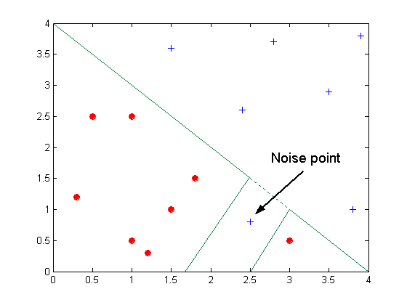
Overfitting due to Noise
Decision boundary is distorted by noise point

Slide 128

Overfitting due to Insufficient Examples
Lack of data points in the lower half of the diagram makes it difficult to predict correctly the class labels of that region
- Insufficient number of training records in the region causes the decision tree to predict the test examples using other training records that are irrelevant to the classification task

Slide 129
Notes on Overfitting
Overfitting results in decision trees that are more complex than necessary
Training error no longer provides a good estimate of how well the tree will perform on previously unseen records
Need new ways for estimating errors

Slide 130
Estimating Generalization Errors
Re-substitution errors: error on training (Σ e(t) )
Generalization errors: error on testing (Σ e’(t))
Methods for estimating generalization errors:
  Optimistic approach: e’(t) = e(t)
  Pessimistic approach:
    For each leaf node: e’(t) = (e(t)+0.5)
    Total errors: e’(T) = e(T) + N × 0.5 (N: number of leaf nodes)
    For a tree with 30 leaf nodes and 10 errors on training
    (out of 1000 instances):
    Training error = 10/1000 = 1%
    Generalization error = (10 + 30×0.5)/1000 = 2.5%
  Reduced error pruning (REP):
    uses validation data set to estimate generalization
    error

Slide 131
Occam’s Razor
Given two models of similar generalization errors, one should prefer the simpler model over the more complex model
For complex models, there is a greater chance that it was fitted accidentally by errors in data
Therefore, one should include model complexity when evaluating a model

Slide 132
Minimum Description Length (MDL)
Cost(Model,Data) = Cost(Data|Model) + Cost(Model)
  Cost is the number of bits needed for encoding.
  Search for the least costly model.
Cost(Data|Model) encodes the misclassification errors.
Cost(Model) uses node encoding (number of children) plus splitting condition encoding.

Slide 133
How to Address Overfitting
Pre-Pruning (Early Stopping Rule)
  Stop the algorithm before it becomes a fully-grown tree
  Typical stopping conditions for a node:
    Stop if all instances belong to the same class
    Stop if all the attribute values are the same
  More restrictive conditions:
    Stop if number of instances is less than some user-specified threshold
    Stop if class distribution of instances are independent of the available features (e.g., using χ ² test)
    Stop if expanding the current node does not improve impurity
    measures (e.g., Gini or information gain).

Slide 134
How to Address Overfitting…
Post-pruning
  Grow decision tree to its entirety
  Trim the nodes of the decision tree in a bottom-up fashion
  If generalization error improves after trimming, replace sub-tree by a leaf node.
  Class label of leaf node is determined from majority class of instances in the sub-tree
  Can use MDL for post-pruning

Slide 135
Example of Post-Pruning
Training Error (Before splitting) = 10/30
Pessimistic error = (10 + 0.5)/30 = 10.5/30
Training Error (After splitting) = 9/30
Pessimistic error (After splitting)
= (9 + 4 × 0.5)/30 = 11/30
PRUNE!
Class = Yes | 20
Class = No | 10
Error = 10/30
Class = Yes | 8
Class = No | 4
Class = Yes | 3
Class = No | 4
Class = Yes | 4
Class = No | 1
Class = Yes | 5
Class = No | 1

Slide 136
Examples of Post-pruning
  Optimistic error?
  Pessimistic error?
  Reduced error pruning?
Case 1:
Don’t prune for both cases
C0: 11
C1: 3
C0: 2
C1: 4
Don’t prune case 1, prune case 2
Case 2:
Depends on validation set
C0: 14
C1: 3
C0: 2
C1: 2

Slide 137
Handling Missing Attribute Values
Missing values affect decision tree construction in three different ways:
  Affects how impurity measures are computed
  Affects how to distribute instance with missing value to child nodes
  Affects how a test instance with missing value is classified

Slide 138
Computing Impurity Measure
Before Splitting:
Entropy(Parent)
= -0.3 log(0.3)-(0.7)log(0.7) = 0.8813
Split on Refund:
Entropy(Refund=Yes) = 0
Entropy(Refund=No)
= -(2/6)log(2/6) – (4/6)log(4/6) = 0.9183
Entropy(Children)
= 0.3 (0) + 0.6 (0.9183) = 0.551
Gain = 0.9 × (0.8813 – 0.551) = 0.3303
Missing value

Slide 139
Distribute Instances
Refund
Yes
No
Probability that Refund=Yes is 3/9
Probability that Refund=No is 6/9
Assign record to the left child with weight = 3/9 and to the right child with weight = 6/9
Refund
Yes
No

Slide 140
Classify Instances
New record:
 | Married | Single | Divorced | Total
Class=No | 3 | 1 | 0 | 4
Class=Yes | 6/9 | 1 | 1 | 2.67
Total | 3.67 | 2 | 1 | 6.67
Refund
Yes
No
NO
MarSt
Single,
Divorced
Married
Probability that Marital Status
= Married is 3.67/6.67
Probability that Marital Status ={Single,Divorced} is 3/6.67
TaxInc
NO
< 80K
> 80K
NO
YES

Slide 141
Other Issues
Data Fragmentation
Search Strategy
Expressiveness
Tree Replication

Slide 142
Data Fragmentation
Number of instances gets smaller as you traverse down the tree
Number of instances at the leaf nodes could be too small to make any statistically significant decision

Slide 143
Search Strategy
Finding an optimal decision tree is NP-hard
The algorithm presented so far uses a greedy, top-down, recursive partitioning strategy to induce a reasonable solution
Other strategies?
  Bottom-up
  Bi-directional

Slide 144
Expressiveness
Decision tree provides expressive representation for learning discrete-valued function
  But they do not generalize well to certain types of Boolean functions
    Example: parity function:
      Class = 1 if there is an even number of Boolean attributes with truth value = True
      Class = 0 if there is an odd number of Boolean attributes with truth value = True
    For accurate modeling, must have a complete tree
Not expressive enough for modeling continuous variables
  Particularly when test condition involves only a single attribute at-a-time

Slide 145
Decision Boundary
Border line between two neighboring regions of different classes is known as decision boundary
Decision boundary is parallel to axes because test condition involves a single attribute at-a-time

Slide 146

Oblique Decision Trees
x + y < 1
Class = +
Class =
Test condition may involve multiple attributes
More expressive representation
Finding optimal test condition is computationally expensive

Slide 147
Tree Replication
Same subtree appears in multiple branches

Slide 148
Model Evaluation
Metrics for Performance Evaluation
  How to evaluate the performance of a model?
Methods for Performance Evaluation
  How to obtain reliable estimates?
Methods for Model Comparison
  How to compare the relative performance among competing models?

Slide 149
Model Evaluation
Metrics for Performance Evaluation
  How to evaluate the performance of a model?
Methods for Performance Evaluation
  How to obtain reliable estimates?
Methods for Model Comparison
  How to compare the relative performance among competing models?

Slide 150
Metrics for Performance Evaluation
Focus on the predictive capability of a model
  Rather than how fast it takes to classify or build models, scalability, etc.
Confusion Matrix:
 | PREDICTED CLASS
ACTUAL CLASS |  | Class=Yes | Class=No
 | Class=Yes | a | b
 | Class=No | c | d
a: TP (true positive)
b: FN (false negative)
c: FP (false positive)
d: TN (true negative)

Slide 151
Metrics for Performance Evaluation…
 | PREDICTED CLASS
ACTUAL CLASS |  | Class=Yes | Class=No
 | Class=Yes | a (TP) | b (FN)
 | Class=No | c (FP) | d (TN)
Most widely-used metric:

Slide 152
Limitation of Accuracy
Consider a 2-class problem
  Number of Class 0 examples = 9990
  Number of Class 1 examples = 10
If model predicts everything to be class 0, accuracy is 9990/10000 = 99.9 %
  Accuracy is misleading because model does not detect any class 1 example

Slide 153
Cost Matrix
 | PREDICTED CLASS
ACTUAL CLASS | C(i|j) | Class=Yes | Class=No
 | Class=Yes | C(Yes|Yes) | C(No|Yes)
 | Class=No | C(Yes|No) | C(No|No)
C(i|j): Cost of misclassifying class j example as class i

Slide 154
Computing Cost of Classification
Cost Matrix | PREDICTED CLASS
ACTUAL CLASS | C(i|j) | + | -
 | + | -1 | 100
 | - | 1 | 0
Model M₁ | PREDICTED CLASS
ACTUAL CLASS |  | + | -
 | + | 150 | 40
 | - | 60 | 250
Model M₂ | PREDICTED CLASS
ACTUAL CLASS |  | + | -
 | + | 250 | 45
 | - | 5 | 200
Accuracy = 80%
Cost = 3910
Accuracy = 90%
Cost = 4255

Slide 155
Cost vs Accuracy
Count | PREDICTED CLASS
ACTUAL CLASS |  | Class=Yes | Class=No
 | Class=Yes | a | b
 | Class=No | c | d
Accuracy is proportional to cost if
1. C(Yes|No)=C(No|Yes) = q
2. C(Yes|Yes)=C(No|No) = p
N = a + b + c + d
Accuracy = (a + d)/N
Cost = p (a + d) + q (b + c)
= p (a + d) + q (N – a – d)
= q N – (q – p)(a + d)
= N [q – (q-p) × Accuracy]
Cost | PREDICTED CLASS
ACTUAL CLASS |  | Class=Yes | Class=No
 | Class=Yes | p | q
 | Class=No | q | p

Slide 156
Cost-Sensitive Measures
Precision is biased towards C(Yes|Yes) & C(Yes|No)
Recall is biased towards C(Yes|Yes) & C(No|Yes)
F-measure is biased towards all except C(No|No)

Slide 157
Model Evaluation
Metrics for Performance Evaluation
  How to evaluate the performance of a model?
Methods for Performance Evaluation
  How to obtain reliable estimates?
Methods for Model Comparison
  How to compare the relative performance among competing models?

Slide 158
Methods for Performance Evaluation
How to obtain a reliable estimate of performance?
Performance of a model may depend on other factors besides the learning algorithm:
  Class distribution
  Cost of misclassification
  Size of training and test sets

Slide 159

Learning Curve
Learning curve shows how accuracy changes with varying sample size
Requires a sampling schedule for creating learning curve:
  Arithmetic sampling
  (Langley, et al)
  Geometric sampling
  (Provost et al)
Effect of small sample size:
  Bias in the estimate
  Variance of estimate

Slide 160
Methods of Estimation
Holdout
  Reserve 2/3 for training and 1/3 for testing
Random subsampling
  Repeated holdout
Cross validation
  Partition data into k disjoint subsets
  k-fold: train on k-1 partitions, test on the remaining one
  Leave-one-out: k=n
Stratified sampling
  oversampling vs undersampling
Bootstrap
  Sampling with replacement

Slide 161
Model Evaluation
Metrics for Performance Evaluation
  How to evaluate the performance of a model?
Methods for Performance Evaluation
  How to obtain reliable estimates?
Methods for Model Comparison
  How to compare the relative performance among competing models?

Slide 162
ROC (Receiver Operating Characteristic)
Developed in 1950s for signal detection theory to analyze noisy signals
  Characterize the trade-off between positive hits and false alarms
ROC curve plots TP (on the y-axis) against FP (on the x-axis)
Performance of each classifier represented as a point on the ROC curve
  changing the threshold of algorithm, sample distribution or cost matrix changes the location of the point

Slide 163


ROC Curve
- 1-dimensional data set containing 2 classes (positive and negative)
- any points located at x > t is classified as positive
At threshold t:
TP=0.5, FN=0.5, FP=0.12, FN=0.88

Slide 164
ROC Curve
(TP,FP):
(0,0): declare everything
to be negative class
(1,1): declare everything
to be positive class
(1,0): ideal
Diagonal line:
  Random guessing
  Below diagonal line:
    prediction is opposite of the true class

Slide 165

Using ROC for Model Comparison
No model consistently outperform the other
  M₁ is better for small FPR
  M₂ is better for large FPR
Area Under the ROC curve
  Ideal:
    Area = 1
  Random guess:
    Area = 0.5

Slide 166
How to Construct an ROC curve
Use classifier that produces posterior probability for each test instance P(+|A)
Sort the instances according to P(+|A) in decreasing order
Apply threshold at each unique value of P(+|A)
Count the number of TP, FP,
TN, FN at each threshold
TP rate, TPR = TP/(TP+FN)
FP rate, FPR = FP/(FP + TN)
Instance | P(+|A) | True Class
1 | 0.95 | +
2 | 0.93 | +
3 | 0.87 | -
4 | 0.85 | -
5 | 0.85 | -
6 | 0.85 | +
7 | 0.76 | -
8 | 0.53 | +
9 | 0.43 | -
10 | 0.25 | +

Slide 167

How to construct an ROC curve
Threshold >=
ROC Curve:

Slide 168
Test of Significance
Given two models:
  Model M1: accuracy = 85%, tested on 30 instances
  Model M2: accuracy = 75%, tested on 5000 instances
Can we say M1 is better than M2?
  How much confidence can we place on accuracy of M1 and M2?
  Can the difference in performance measure be explained as a result of random fluctuations in the test set?

Slide 169
Confidence Interval for Accuracy
Prediction can be regarded as a Bernoulli trial
  A Bernoulli trial has 2 possible outcomes
  Possible outcomes for prediction: correct or wrong
  Collection of Bernoulli trials has a Binomial distribution:
    x ∼ Bin(N, p) x: number of correct predictions
    e.g: Toss a fair coin 50 times, how many heads would turn up?
    Expected number of heads = N×p = 50 × 0.5 = 25
Given x (# of correct predictions) or equivalently, acc=x/N, and N (# of test instances),
Can we predict p (true accuracy of model)?

Slide 170

Confidence Interval for Accuracy
Area = 1 - α
For large test sets (N > 30),
  acc has a normal distribution
  with mean p and variance
  p(1-p)/N
Confidence Interval for p:
Z_{α/2}
Z_{1- α /2}

Slide 171
Confidence Interval for Accuracy
Consider a model that produces an accuracy of 80% when evaluated on 100 test instances:
  N=100, acc = 0.8
  Let 1-α = 0.95 (95% confidence)
  From probability table, Z_{α/2}=1.96
1-α | Z
0.99 | 2.58
0.98 | 2.33
0.95 | 1.96
0.90 | 1.65
N | 50 | 100 | 500 | 1000 | 5000
p(lower) | 0.670 | 0.711 | 0.763 | 0.774 | 0.789
p(upper) | 0.888 | 0.866 | 0.833 | 0.824 | 0.811

Slide 172
Comparing Performance of 2 Models
Given two models, say M1 and M2, which is better?
  M1 is tested on D1 (size=n1), found error rate = e₁
  M2 is tested on D2 (size=n2), found error rate = e₂
  Assume D1 and D2 are independent
  If n1 and n2 are sufficiently large, then
  Approximate:

Slide 173
Comparing Performance of 2 Models
To test if performance difference is statistically significant: d = e1 – e2
  d ~ N(d_{t},σ_{t}) where d_{t} is the true difference
  Since D1 and D2 are independent, their variance adds up:
  At (1-α) confidence level,

Slide 174
An Illustrative Example
Given: M1: n1 = 30, e1 = 0.15
M2: n2 = 5000, e2 = 0.25
d = |e2 – e1| = 0.1 (2-sided test)
At 95% confidence level, Z_{α/2}=1.96
=> Interval contains 0 => difference may not be
statistically significant

Slide 175
Comparing Performance of 2 Algorithms
Each learning algorithm may produce k models:
  L1 may produce M11 , M12, …, M1k
  L2 may produce M21 , M22, …, M2k
If models are generated on the same test sets D1,D2, …, Dk (e.g., via cross-validation)
  For each set: compute d_{j} = e_{1j} – e_{2j}
  d_{j} has mean d_{t} and variance σ_{t}
  Estimate:

